Slide 1



DENTAL UPDATES
2022

Slide 2

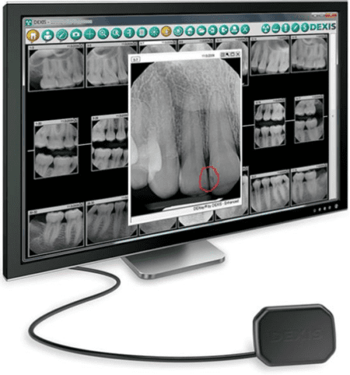
MiPacs
Imaging
Remember or remind your Dentist to save images when taken.
If for any reason the computer were to go down and images
have not been saved, there is no way to retrieve them.
If you need assistance retrieving X-Rays in your office you need to contact the IT Help Desk by sending an email to COAHelp@childrensal.org

Slide 3












Supplies Brought in from your Office:
1. Sterile Items – The only item sterilized in your office allowed to be brought for use in the O.R. is burrs.
If a specialty item or instrument is needed for any case, it must be brought to Sterile Processing 3 days in
advance with manufacturer’s Instructions for Use for sterilization parameters – no exceptions.
2. All other supplies must be in original manufacturer’s containers with current Expiration Dates. All Dates will be checked by both the Dental Assistant and the O.R. RN Circulator. Any expired items will be removed from the O.R.
Counts:
Every Dental Assistant is taught what and how to count items prior to and after a procedure during their orientation. This is to be done for every case by the Dental Assistant and the Circulating Nurse. We are changing our end of case work flow to improve our end of case count process. We want to leave the Assistant’s tables at the bedside until all final counts are completed.

Slide 4

History and Physicals
All patients are required to have an H & P within 30 days prior to their procedure. Due to this, please be careful when scheduling cases.
Example: If a patient has their H&P done on the first day of October and are scheduled for their procedure the November 1st their H&P will be past the 30 days. If they come to the O.R. on November 1st their case will be cancelled.

Slide 5

Scheduling
of
Cases
Be aware all Block time drops off 3 days prior to the surgery day.
Example: If you want to do a case on Friday it must be scheduled on Tuesday.
If requested to be scheduled after block time has dropped, one of three things will happen.
1. The case will not be scheduled
2. The case may be scheduled but will follow other
cases in Lowder already on the schedule
3. The case may be scheduled in Benjamin Russell after other cases already on the schedule
If your Dentist will not be utilizing their block time, they must release their block time two weeks in advance. If they do not release their block time and do not use the time, this will count against them on the block utilization report and can result in a decrease or loss of block time.

Slide 6


New Assistant Application Process
Current application is available on the Surgery Resources Page. Please DO NOT use an older version to apply since changes are made frequently.
Email all applications to Taylor.Cleveland@childrensal.org
Application fee is $50.00
The fee has to be paid by check made out to Children’s of Alabama and mailed in with the correct pages of the application to Medical Staff Services.
Applications will not be approved until the application and fee have been received and the Background Check has been completed.
Once the Applicant has been approved and all supporting documentation received, your office will be contacted by Taylor to arrange a date for the Orientation Class. Applicants must complete this course before working in the O.R.
All Applicants will be required to apply for a Badge. (Directions are on the Surgery Resources Page) Parking will be free in the 5th Avenue Parking Deck only.

Slide 7


Orientation Class for New Applicants
All new Dental Assistants are required to attend the 2 ½ hour Orientation Class prior to working in the O.R. Classes will be offered once a month.
Course Includes:
*Information for Computer Access
*Education on difference between working in an office and working in the O.R. with patients asleep versus awake
*Review of O.R. Pertinent Policies
*Tour of the O.R.
*Validation of Competencies taught in class
All New Applicants will be required to read and acknowledge policies assigned in Lucidoc and complete courses in Children’s University.
**They are given 30 days from the date of their Orientation Class to complete these. If not completed, applicant will be required to reapply.

Slide 8

Renewal of privileges
All Information will be due by May 31, 2023. If all requirements are not met by the due date, the applicant will be required to reapply, including the $50.00 fee.
All Renewal Items are to be emailed to Taylor.Cleveland@childrensal.org
Items Required:
*Valid BLS Card from American Heart Association
*Record of Flu Vaccine given within 12 months
*Proof of Liability Insurance with Assistant’s name listed
*Current Evaluation from Dentist (Form is on the Resources page)
*Annual TB Mask Fit Test – to be done in the O.R.
Major Change – Assistants will no longer be required to do the Annual
Curriculum in Children’s University.
Effective, January 1st, 2023: COA emails will no longer be used for correspondence with the assistants. Personal emails on file will be used instead. If we do not have one on file, we will be reaching out to get one.

Slide 9
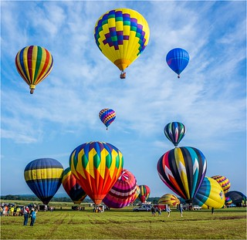
If an Assistant Leaves your Office
COLLECT THEIR COA BADGE & RETURN IT TO AN O.R. MANAGER SO WE CAN TURN IT IN TO SECURITY
NOTIFY TAYLOR IMMEDIATELY VIA EMAIL.
** Due to HIPPA Laws, we are required to request the Assistant be deactivated from our systems.

Slide 10

Thank you for joining us at the Carnival!
Do you have any QUESTIONS ?

