Slide 1

Nutrition for Diabetes
Department of Clinical Nutrition

Slide 2
Objectives
Demonstrate use of MyPlate guidelines.
Explain how different foods affect blood glucose.
Identify “free foods” and concentrated sweets.
Importance of timing meals and snacks to balance insulin.
Verbalize the number of carbohydrate per serving in a sample meal.
Demonstrate ability to read a food label.
Verbalize proper use of sugar substitutes.
State why it is important to be heart healthy as a patient with diabetes.
Notes:
1) State the rationale for managing carbohydrate intake in diabetes
2) Identify foods containing carbs
3) Demonstrate how to count carbs using a sample menu
4) Verbalize how to read a nutrition facts label
5) Discuss why it is important to be heart healthy as a patient with diabetes

Slide 3
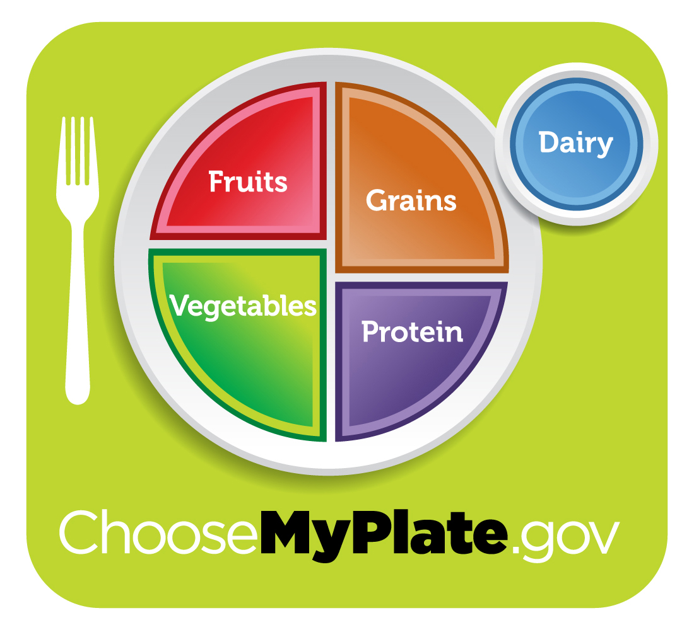
My Plate

Slide 4
Identify carbohydrate
food sources
Breads, Starches, and Starchy Vegetables
Fruit
Milk and Milk Products
Sweets and other desserts
Carbohydrate counting has been shown to improve HgbA1c levels in patients with type 1 diabetes.
Source:
Gosken D, et al. Effects of carbohydrate counting method on metabolic control in children with type 1 diabetes mellitus.
Clinical Research in Pediatric Endocrinology. 2014;6(2):74-8. doi: 10.4274/Jcrpe.1191.

Slide 5
Food group educated guesses
For grains, starchy vegetables, and fruit:
1 carbohydrate choice/serving =
15 grams of carbohydrate
For milk:
1 carbohydrate choice/serving =
12g of carbohydrate

Slide 6


The Bread and Starch Group
Each serving = 15 grams of carbohydrate
Starches | Serving
Bread, pasta, rice, crackers, cereal, and snack foods | 1 slice of bread ⅓ cup of rice (cooked) ½ cup pasta (cooked) 1 small roll ½ bun 15 chips 3 cups popcorn
Corn, potatoes, dried beans and peas | ½ cup cooked
Notes:
Starches
Bread, pasta, rice, crackers, cereals, snack foods
Starchy Vegetables
Corn, potatoes, dried beans and peas

Slide 7


The Fruit Group
Each serving = 15 grams of carbohydrate
Fruit | Serving
Fresh fruit | 1 cup ½ banana 15 large grapes Tennis-ball sized piece
Canned fruit (packaged in 100% fruit juice) | ½ cup, packed in water / juice
100% fruit juice | 4 ounces
Dried fruit | 2 Tablespoons

Slide 8

The Milk Group
Each serving = 12 grams of carbohydrate
Milk Product | Serving
Milk (whole, 1%, 2%, or skim) *Check labels for flavored milk or dairy alternatives | 8 ounces
Yogurt | 6 ounces fat free
Pudding and ice cream | ½ cup no added sugar

Slide 9
A “FREE” food is one that contains less than 20 calories.
Is less than or equal to 5 grams of total carbohydrates per serving.
Examples (serving size is important!!):
FREE Foods
Food | Carbohydrate content
1 Tablespoon ketchup | 5 g carbs
1 Tablespoon fat free dressing | 4 g carbs
2 Tablespoon salsa | 3g carbs
1 Tablespoon peanut butter | 4 g

Slide 10
Examples of FREE foods
½ cup non-starchy vegetables cooked
1cup non-starchy vegetables raw
Sugar-free and Diet drinks
Unsweetened Tea and Coffee
Sugar-free jell-o and popsicles
Mustard
Dill Pickles
Sweet Pickles (made with Splenda ®)
Artificial sweeteners
  Equal®, Sweet & Low®, Splenda®, Truvia/Stevia®

Slide 11
Non-starchy vegetables:
½ cup non-starchy cooked vegetables= Free
1 cup non-starchy vegetables raw= Free
Each serving over = 5 g carbs
Artichoke
Asparagus
Green, wax and Italian beans
Bean sprouts
Beets
Broccoli
Brussels sprouts
Cabbage
Cauliflower
Celery
Cucumber
Eggplant
Green Onions or scallions
Greens (collard, kale, mustard, turnip)
Leeks
Mushrooms
Okra
Onions
Peppers (all varieties)
Radishes
Sauerkraut
Salad Greens
Snow Peas
Spinach
Summer Squash (Yellow)
Tomato
Turnips
Water Chestnuts
Watercress
Zucchini

Slide 12
Meal timing
Meals:
3 meals per day with a balance of carbohydrate, protein, fat, and fiber.
Amount of carbohydrate per meal is dependent on child’s age, size, and activity level.
Snacks
1 carbohydrate containing snack between meals that is less than 15 g carbohydrate (1-3 snacks per day).
Limit to 1 free snack (less than 5 g CHO) between meals (2 per day).

Slide 13
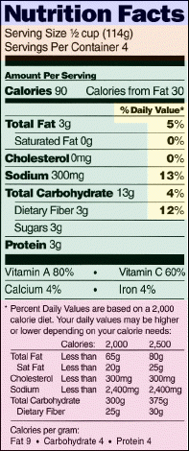
Reading the nutrition
facts label
-Look at Serving Size first
-Then total carbohydrate
*Look at servings per container.

Slide 14
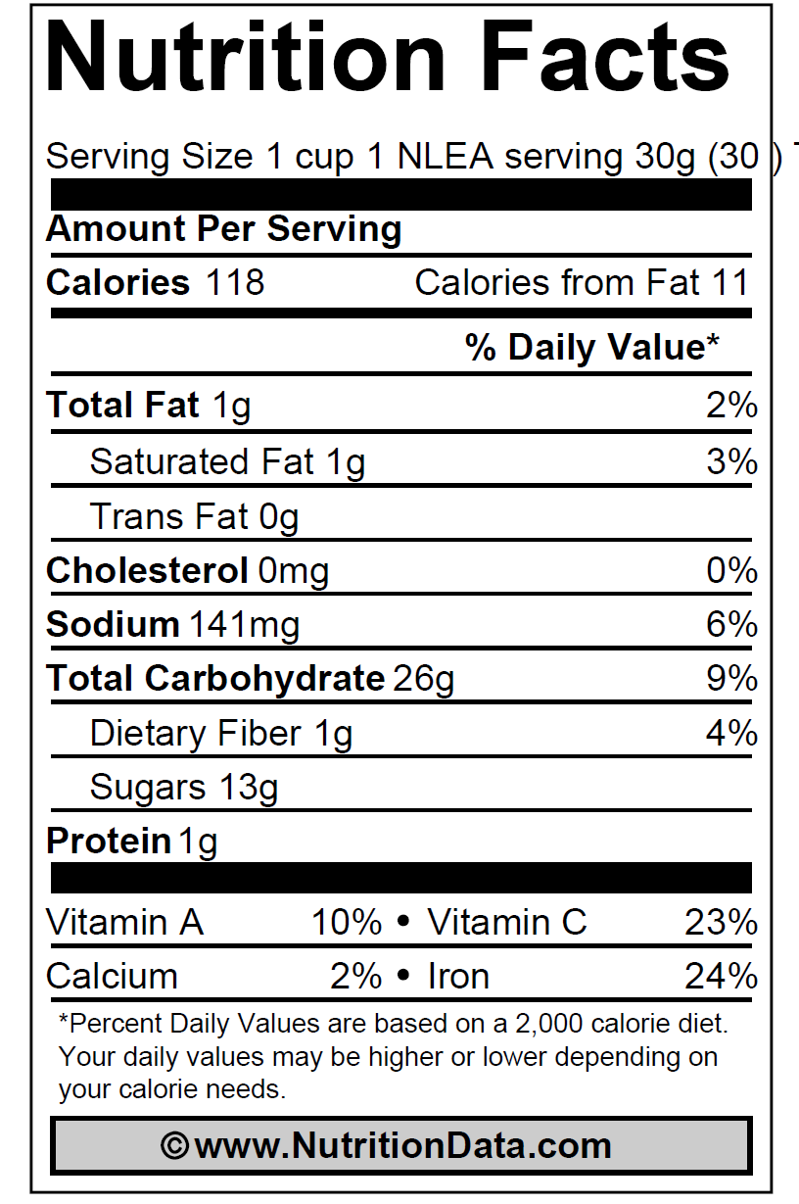
Added sugar:
Cheerios® VS. Fruit Loops®

Slide 15
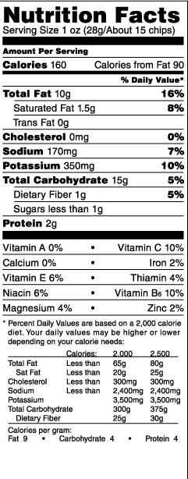
Meal example
Lunch:
1 sandwich made with:
  2 slices of bread = ___ grams
  3 slices of turkey meat = __ grams
  1 slice of cheese = __ grams
  1 tsp of mustard = __ grams
1 small apple = __ grams
1 bag of chips (use label)= __ grams
What is the total amount of carbohydrate
for the meal? ____________ grams

Slide 16
Meal example
Lunch:
1 sandwich made with:
  2 slices of bread→ 30 grams
  3 slices of turkey meat→ Free
  1 slice of cheese→ Free
  1 tablespoon of mustard → Free
1 small apple → 15 grams
1 bag of chips → 15 g
What is the total amount of carbohydrate for the meal? 60 grams

Slide 17

Heart Healthy Eating & Exercise
Diabetes increases risk for heart disease, so maintaining a heart healthy diet is important!
What to look for??
  Foods with less saturated fat: “Lean, Fat-Free, Reduced Fat or Made with Olive Oil”
  Food with lower cholesterol & higher unsaturated fat: Nuts, nut butters, seeds, avocados, avocado oil, olives, olive oil, beans, lentils, chickpeas, tofu, tempeh, edamame
What to avoid??
  Avoid processed pre-packaged foods such as snack cakes, honeybuns, pre-packaged cookies, donuts, muffins, candy bars, candy, ramen, crackers, cheese flavored items, fried chips
  Limit fried food: to 1x/week or as much as possible!
Exercise:
  1 hour each day for heart health & improved blood glucose
Notes:
Source: Homma TK¹, et al. Dyslipidemia in young patients with type 1 diabetes mellitus. Archives of Endocrinology and Metabolism. 2015 Jun;59(3):215-9. doi: 10.1590/2359-3997000000040
Soliman EZ¹, Backlund JY², Bebu I², Li Y³, Zhang ZM³, Cleary PA², Lachin JM². Progression of Electrocardiographic Abnormalities in Type 1 Diabetes During 16 Years of Follow-up: The Epidemiology of Diabetes Interventions and Complications (EDIC) Study. Journal of the American Heart Association. 2016 Mar 14;4(3):e002882. doi: 10.1161/JAHA.115.002882

Slide 18
Heart Health Eating
Heart Healthy Lean Proteins: Meats, Seafood & Eggs
  Lean Meats/ Proteins: “The fewer legs, the better”
  Fish high in omega-3 fatty acids: albacore tuna, herring, mackerel, rainbow trout, sardines & salmon are great, but all fish are good choices.
  Other Seafood's: shellfish- clams, crab, imitation shellfish, lobster, shrimp, and oysters
  Poultry: Chicken & turkey- without the skin, choose white meat over dark
  90%-97% lean ground beef or turkey- always drain after cooking
  Red Meat: Steaks “Choice or select” lean cuts with the fat trimmed (rounds, sirloin tips, center cut, chuck, cubed, rump roast, porterhouse, tenderloin, T-bone )
  Cooking/ Preparation Methods: grilled, baked, air fried, boiled or braised
  Ground meats should be drained, skins removed, trim the fat, don’t deep fry, use vegetable oils instead of butter or lard
  Low-fat or Fat-free dairy: Milk, cheese, yogurt (including Greek Yogurt), cream cheese, sour cream instead of the whole-fat options
  Eggs: Use egg whites or egg-beaters & fewer whole eggs
  Source: Homma TK¹, et al. Dyslipidemia in young patients with type 1 diabetes mellitus. Archives of Endocrinology and Metabolism. 2015 Jun;59(3):215-9. doi: 10.1590/2359-3997000000040
Soliman EZ¹, Backlund JY², Bebu I², Li Y³, Zhang ZM³, Cleary PA², Lachin JM². Progression of Electrocardiographic Abnormalities in Type 1 Diabetes During 16 Years of Follow-up: The Epidemiology of Diabetes Interventions and Complications (EDIC) Study. Journal of the American Heart Association. 2016 Mar 14;4(3):e002882. doi: 10.1161/JAHA.115.002882

Slide 19
Fiber
Fiber is the indigestible part of plant foods.
Recommended Intake: 14 grams per 1000 calories
1 cup vegetables has 3 grams of fiber.
Remember to look for “whole-grain” or “whole wheat” products (1st ingredient).
Notes:
FIBER?

Slide 20
Fiber
Drink plenty of water with high fiber!
Insoluble Fiber
  Keeps you regular!
  Sources: Whole grain, whole wheat foods; Nuts & seeds; Fruits, Vegetables
Soluble Fiber
  Heart Healthy, Lowers Cholesterol
  Sources: Oats, oat bran, oatmeal, Dried beans & peas, Fruits, Vegetables
High fiber food = Greater than 5 grams dietary fiber

Slide 21
Fiber trick:
If a serving size of a carbohydrate product has more than 5 grams of Dietary Fiber or Sugar Alcohol,:
Divide the dietary fiber grams by 2.
Subtracted from total carb grams = Net carb per serving of product.

Slide 22
Spaghetti-whole wheat (cooked)
Fiber= 6g
Carb= 37g
Carb (37)- ½ fiber (3)= 34g carb adjusted

Slide 23
Sugar alcohol & sweetener tips
Sweeteners are safe for consumption per The Food and Drug Administration (FDA)
Sugar alcohols do not contain alcohol (liquor)
  Examples: erythritol, isomalt, lactitol, maltitol, mannitol, sorbitol, xylitol
  The Academy of Nutrition and Dietetics “advises that intakes greater than 50 grams/day of sorbitol or greater than 20 grams/day of mannitol may cause diarrhea.”
TRICK: If a product contains >5g sugar alcohol, you can subtract one half of the sugar alcohol grams from the total carbohydrate grams

Slide 24
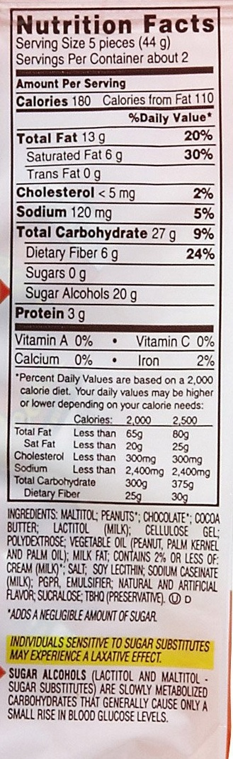
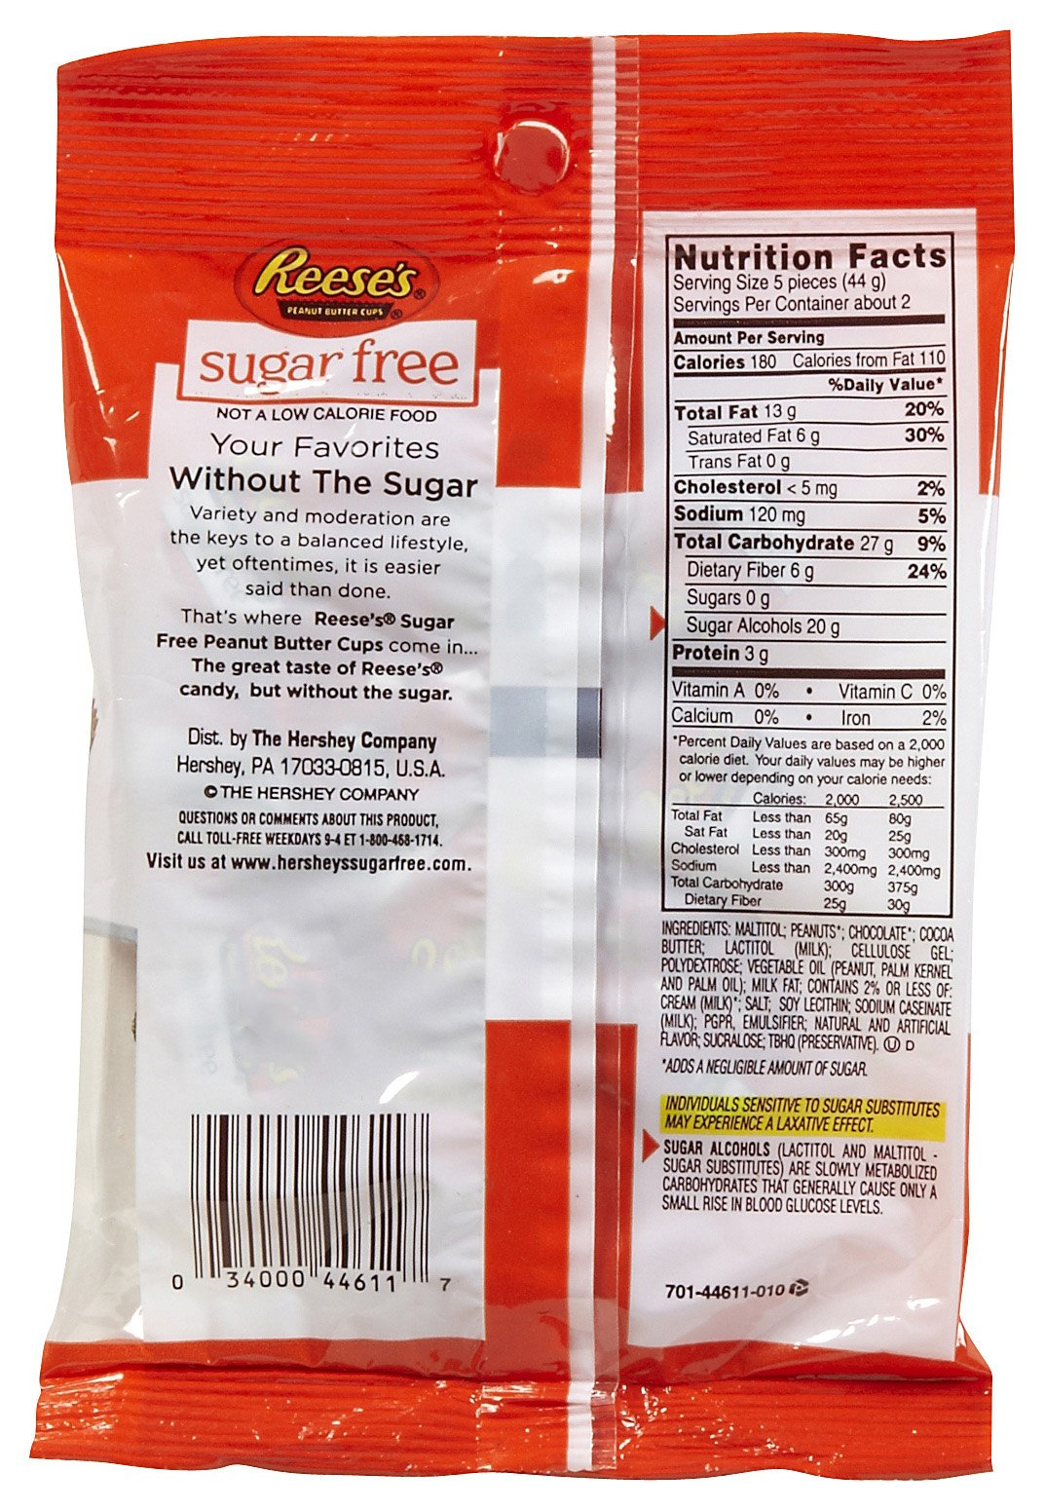
“Sugar-Free” DOES NOT mean “Carbohydrate- Free”
*Only use fiber or sugar alcohol, not both. Choose whichever is the higher number.*

Slide 25
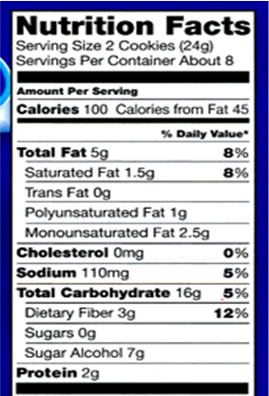
Sugar free Oreos®
Sugar Alcohols= 7g
Half of 7= 3.5g
Total Carb= 16g
Carb (16) - half sugar alcohol (3.5) = 12g* carbohydrate adjusted
*rounded down for easy math

Slide 26

Water
Very important nutrient!
Drink 6-8 cups (8-ounces) per day
Drink MORE than recommended with illness and when ketones present

Slide 27
Helpful websites and apps
Websites: Helpful information and recipe ideas.
  www.choosemyplate.gov
  www.diabetesfoodhub.org
Apps: Use these apps to find foods when they do not have a food label.
  MyFitnessPal: Once you get to the diary, your recent look ups will save for quick reference in the future. This is still an estimate of carbohydrates. Remember to change serving sizes.
  CalorieKing: Useful to look up food when eating out.

Slide 28
Points to remember
1 serving Carb = 15 grams
ALWAYS read the label- serving size and total carb
Cook heart healthy
Choose high fiber foods
Water is the most important nutrient, so drink at least 6-8 cups per day

Slide 29

Questions

