Slide 1
October 10, 2023
9:30 – 10:30 AM

Slide 2
Disclosure
As a result of this activity, the learner will be able to identify the services and resources provided by the Alabama Poison Information Center.
To successfully complete this activity the learner must attend at least 90% of the activity and must complete and submit the evaluation.
This educational activity does not include any content that relates to the products and/or services of an Ineligible company with whom there is a financial relationship.
There is no commercial support being received for this event.
Children’s of Alabama is an approved provider of nursing continuing education by the Alabama Board of Nursing (ABN): ABNP0113, Expiration Date: 03/31/2025.
Children’s of Alabama is approved as a provider of nursing continuing professional development by the Northeast Multistate Division Education Unit, an accredited approver of continuing nursing education by the American Nurses Credentialing Center’s Commission on Accreditation. Provider Number: 5-173, Expiration Date: 09/14/2025

Slide 3
Objectives
As a result of this activity, the learner will be able to:
List changes that occurred with the Alabama Poison Information Center during 2020-2021 (COVID-19).
Identify programs associated with the Alabama Poison Information Center.
Explain the importance of post antivenin snakebite management.
Recognize tianeptine and its toxicity.

Slide 4
If you have any questions, please type them in the Q & A section throughout the presentation.

Slide 5
Updates from the Alabama Poison Information Center
Ann Slattery DrPH, RN, RPh, DABAT, FAACT
Director, Alabama Poison Information Center

Slide 6
Disclosure
I have no actual or potential conflict of interest in relation to this program/presentation.

Slide 7
Objectives
List changes that occurred with the Alabama Poison Information Center during 2020-2021 (COVID-19).
Identify programs associated with the Alabama Poison Information Center.
Explain the importance of post antivenin/antivenom snakebite management.
Recognize tianeptine and its toxicity.

Slide 8
Alabama Poison Information Center
Established in 1958 at Children’s Hospital of Alabama
Covers the entire state of Alabama
Receives calls about all ages
4 hours old to 105 years old
In 2022, APIC received >50,000 calls and made ~60,000 follow up calls…
Notes:
14 RNs and 7 pharmacist, Name changed 3/16/2022 During the pandemic in 2020 are followups increased 14th oldest poison center in the United States. Only nurses, pharmacist, PA, and MDs are allowed to answer our phones. Only real time surveillance in the United States.

Slide 9
2022 APIC Annual Report

Slide 10
2022 APIC Annual Report

Slide 11
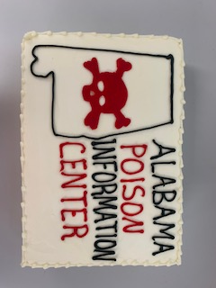
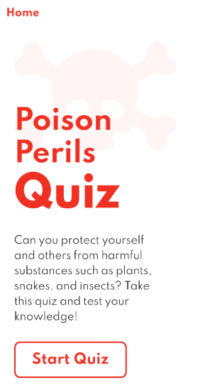
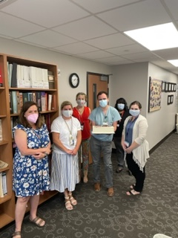
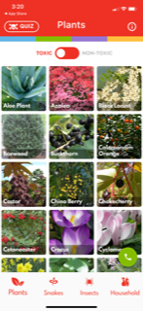
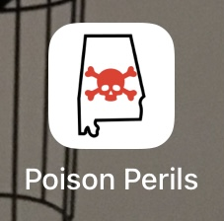
Name Change
Alabama Poison Information Center
Celebration Planned
Poison Perils of Alabama
Notes:
No one seems to know we are or that we exist 1958 children’s hospital poison center, mid 1980’s Regional Poison Control Center, 2018 60’s year anniversary 9/2018 Senate Shelby wrote us a congratulation letter on covering the Region of Birmingham
Media was to attend, I requested a big bow and ribbon to cut and a pair of giant scissors, order a cake and food for 100+ Thought we would announce and celebrate when COVID -19 was over, after 18 months, we had smaller cakes made and we ate cake for 2 weeks

Slide 12
APIC Call Volume
~ 7% increase total calls
Calls originated
Prior 2020 70% public and 30% HCF
2020-2021 77% public and 23% HCF
Age distribution changed
2020 ↑ 8.3% 65+ yo
2021 ↑7.2% 65+ yo
Notes:
The Alabama Opioid Overdose and Addiction Council is raising awareness about the increased number of opioid overdose deaths in 2020. Opioids are drugs such as heroin, fentanyl and prescription medications like hydrocodone and oxycodone.
According to a National Center for Health Statistics report released the last week of 2021 using official annual mortality data, 91,799 Americans died from drug overdoses in 2020. This is an astounding 31 percent increase over the 2019 rate and the largest year-over-year rate increase on record. Additional data suggests that 2021 drug overdose deaths continued to increase, underscoring the negative impact the COVID-19 pandemic has had on the health and well-being of Americans.

Slide 13
APIC Patient Satisfaction Survey
If the poison center was not available what would you have done?
Prior 2020 – 43% would have called or visited their primary care physician, 32% would have gone to the emergency department.
2020-2021 - 49% would have called or visited their primary care physician, 25% would have gone to the emergency department.

Slide 14
Remote Workers and PIPS
Remote workers
Increase of clin tox call
Poison Information Providers
Notes:
1300 to 1800 calls
We were slotted to go remote in June 2020 for surge and disaster plan (had a duplicate set up in a training room in the hospital).

Slide 15
Unique Calls
Bleach – ↑ 17% increase (all cleaning products ↑ 11.8%)
Chloroquine/hydroxychloroquine – ↑ 69% increase
Ivermectin – ↑80% increase
Notes:
(3/16/2018-12/31/2020) (3/20-12/21) chloroquine 23 vs 39 Bleach 1276 vs1491 ivermectin 67 vs 121

Slide 16
Cleaning Products 2019 versus 2020
Notes:
March through May a 30% increase

Slide 17
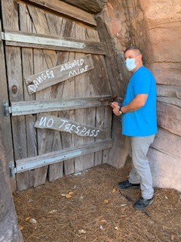
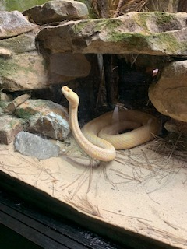
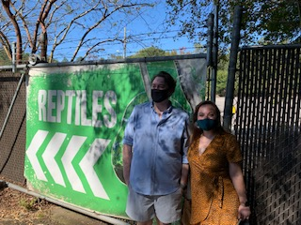
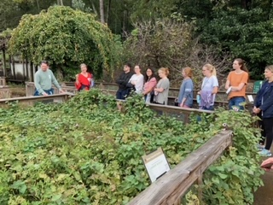
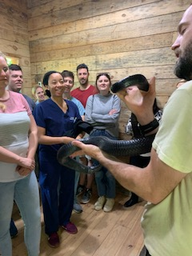
Remote Rotations
ZOOM
Birmingham Zoo Reptile House
Botanical Gardens
Notes:
Quickly completed our March rotation, August 2020 we began back with rotations contacted Dan Self Curator of the Reptile House. Also took PYG1 Pharmacy residents, UAB EM residents, class to botanical gardens.

Slide 18
APIC Partners
AAPCC, now the America’s Poison Centers
BCBS – funds special APIC projects (Pitt’s BCBS of AL Tox Fellowship)
EPA – mercury and testing
HRSA (CDC)– Poison Control Program; CARES Funds for Poison Centers
ADPH
ToxSentry CEP – Delta 8
ELC 115 Emerging Infectious Disease – Clinical Effects Surveillance
HCCA – continued visiting every day care except one quarter
HIDTA – DEA submit annual reports
Alabama Opioid Overdose and Addiction Council - CDR
Notes:
4 Chairpersons of SPI Committee, 2 Editors for the FYI publication goes to all 55 PC and 900 SPIs In 2005 APIC hosted the first national webinar for SPIs, I am one of 11 members of the Accreditation committee ((12 years)
164 clinical effects that NPDS gathers, central data repository

Slide 19
Clinical Effects - Constellation

Slide 20
Other Heme/Hepatic
Notes:
Palytoxin, salmonella, Harmful algae blooms AB

Slide 21
Other Heme/Hepatic - Infectious Disease

Slide 22
Tachycardia – Infectious Disease
Notes:
http://sv-p-tableau/#/signin?disableAutoSignin=yes
Abdominal pain, nausea, vomiting, diarrhea, and a metallic taste in the mouth are prominent early symptoms. Other signs and symptoms include: acute respiratory distress, tachycardia, skeletal muscle tonic contractions, muscle pain, myoglobinuria, rhabdomyolysis, hemolysis, seizures, paresthesias, dysesthesia, dizziness, elevated liver enzyme levels, cyanosis, bradycardia, and renal failure. Respiratory failure due to myopathy has resulted in death.
Leukocytosis has been reported in patients after inhalational exposure to anemones of the Palythoa species (Davey et al, 2015; Sud et al, 2013; Bernasconi et al, 2012; Majlesi et al, 2008). b) CASE REPORT: INHALATION: A 32-year-old man developed leukocytosis with a WBC of 21,000 after inhaling steam emitted from a Palythoa coral that he had removed from his aquarium and drenched with boiling water in an attempt to kill it.

Slide 23
What’s Trending Weekly Digest (last week 9/24/2023 – 9/30/2023)
Notes:
4/23-4/29 sent 5/2/23

Slide 24
Fentanyl
Fentanyl Exposures By Year (APIC)
Year | Prescription | Non-Prescription | Total
2017 | 6 | 4 | 10
2018 | 15 | 3 | 18
2019 | 14 | 16 | 30
2020 | 7 | 18 | 25
2021 | 7 | 48 | 55
2022 | 8 | 94 | 102
2023 (10/04/23) | 3 | 86 | 89
Notes:
Last two weeks in September…also minor cannabinoids

Slide 25
Alabama Opioid Overdose and Addiction Council https://druguse.alabama.gov/
https://druguse.alabama.gov/
Notes:
Central data repository

Slide 26
Opioid Exposures to APIC Last Rolling Year
https://druguse.alabama.gov/poisoncontrol.html

Slide 27
Opioid Exposures to APIC Last 7 years
https://druguse.alabama.gov/poisoncontrol.html
Notes:
Fourth quarter 2021 fentanyl surpassed heroin

Slide 28
APIC Partners
ALSDE – Naloxone training for school RNs and naloxone training for unlicensed personnel
Alabama Radiation Control Office
R4PC3 - Region 4 Poison Control Center Collaborative
Radiation Exposure/Contamination with Radioactive Material
Novichok Guideline
SRDRS – Southern Regional Disaster Response System
AARP/Addiction Prevention Coalition
McWhorter and Harrison Schools of Pharmacy, UAB Med Tox, PGY1&2
Notes:
https://www.alabamaachieves.org/wp-content/uploads/2021/04/Naloxone-Training-Program-January-2019-final-draft.pdf
Myron Riley
Medication Safety, Medicine cabinet is the new drug dealer and the poisonous purse, keeping all drugs out of sight
JCDH training free of charge naloxone
The name Novichok means “newcomer”. It is used for a family of highly toxic nerve agents with a composition slightly different from the better known poison gases VX and sarin.

Slide 29
Snakebites
7000-8000 per year in the United States with an average of 5 deaths per year
In Alabama only 10% of snakebites are from rattlesnakes, the most common are copperheads and cottonmouths/water moccasins
30-50% of snakebites are dry bites
Most common complications are
Local wound damage
Swelling of the extremities
Painful blood blisters
Notes:
Agkistrodon
110 YTD 10/5/23

Slide 30
Morbidity Associated with Snakebite Envenomation
88% - time lost from work average 13.9 days
79% - had pain at the site at 16.4 days post
68% - edema at site at 15.6 days post
16% - recurrent edema and pain at 31 days post
Spiller HA, Bosse GM. Prospective study of morbidity associated with snakebite envenomation. J Toxicol Clin Toxicol. 2003;41(2):125-30. doi: 10.1081/clt-120019127. PMID: 12733849.

Slide 31
North American Snakebite Registry
10.7% had residual limb defects
No follow-up on ~40% of patient in registry

Slide 32
Why?
Physicians may be uncomfortable treating snakebites and doing follow-up
Patients do not know who or where to receive care
Notes:
Georgia patient last week

Slide 33
CoA/UAB Comprehensive Snakebite Program
https://www.uabmedicine.org/specialties/uab-comprehensive-snakebite-program/
https://www.childrensal.org/news/comprehensive-snakebite-program-offers-multidisciplinary-care-snakebite-victims
Long term effects of snakebites
Chronic limb swelling
Wound
Muscle damage
Notes:
When a snake bites a person, often on the foot, the tissues fill up with blood, Rushton explains. “For someone with little experience of snakebite,” that swollen leg can look like dead, necrotic tissue that needs to be removed to avoid wider damage. “That’s a hallmark of our program, to keep people away from surgeons,” Rushton said. “These large blood blisters are cared for by a wound-care specialist who has a lot more understanding of the mechanisms of envenomation. What we don’t want is someone trying to debride [cut away] that tissue.”

Slide 34
UAB Comprehensive Snakebite Clinic
The UAB Comprehensive Snakebite Clinic focuses on four common post-bite complications:
persistent swelling of the extremities
bad blood blisters
range-of-motion activity
rebound coagulopathy
Notes:
Patients who are not treated at UAB have their care augmented by the Alabama Poison Information Center (APIC) at Children’s of Alabama. Any physician in the state can consult with experts at APIC for recommendations and care input. APIC covers all health care facilities in the state of Alabama and is available 24/7 for patient and/or physician consultation.
Treatment may continue after hospital discharge. Outpatient follow up is available at the UAB Comprehensive Wound Care Clinic, where specialists work closely with the APIC for long-term lab monitoring of potential venom injury while providing strategies for treatment of limb swelling and localized wound care. Physical therapy is available for those patients who require improved limb function recovery.

Slide 35
CoA/UAB Comprehensive Snakebite Program
Alabama Poison Information Center offers follow up to all reported snakebite envenomation regardless of there of their location
1. Working Phone Number
2. Date of Birth
3. # of Vials and type of antivenin/antivenom (Crofab or Anavip) given
4. Bite Location
5. Date of bite
6. Dates of hospitalization
• The clinic will contact the patient within 48 hours after discharge
to set up an appointment
Notes:
Offered regardless of insurance. Call two weeks ago from a patient in Georgia called UAB Snakebite Clinic and is being seen at UAB

Slide 36
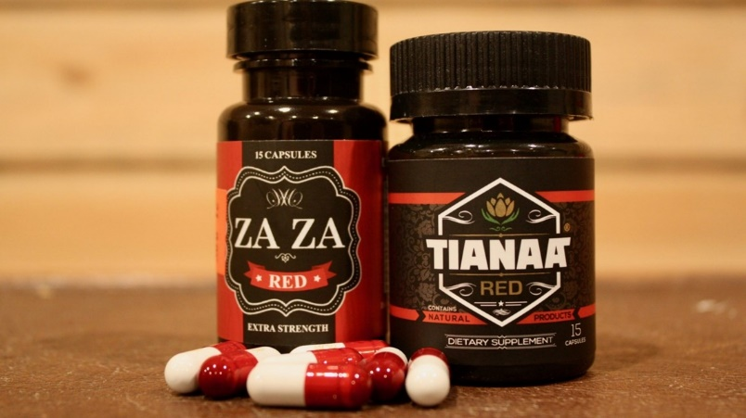
Tianeptine
Structure similar to a tricyclic antidepressant
Approved in several European countries
Not FDA approved in the United States
Sold online or convenience stores as ZaZa or Tianna Red
Larger doses used as an opioid substitute

Slide 37
Tianeptine
48 cases from January 2015 to March 2020, 37 (77%) May 2019 – March 2020
17 cases were due to tianeptine intoxication
31 cases were due to tianeptine withdrawals
127 cases from April 2020 through March 2021 – 85 (67%) reason for exposure was intentional abuse or for withdrawals

Slide 38
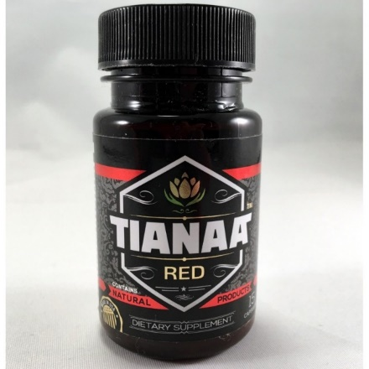
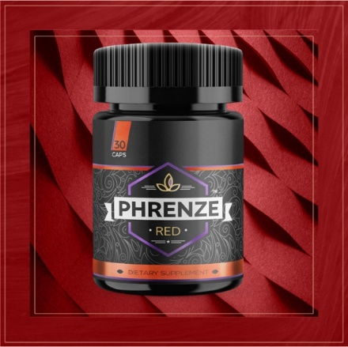
Tianeptine
Tianeptine was added to the controlled substance list in 2020 in Alabama then withdrawn in November
March 15 , 2021 Alabama classified tianeptine as a Schedule II controlled substance
Overdoses - lethargy and agitation
Treated with naloxone and benzodiazepines
Withdrawal – agitation, N&V, tachycardia, and tremors
Treated with benzodiazepines and dexmedetomidine
Entered Phrenze Red - contains phenibut and kava
Notes:
DEX MED E TOM idine
Premier Manufacturing Products, a Florida-based dietary supplement company, filed a motion Nov. 9 to place a restraining order on the impending action, citing ADPH’s failure to file an economic impact statement, stating the potential impacts of banning tianeptine in Alabama.

Slide 39
Phenibut
Beta-phenyl-gamma-aminobutyric acid HCL (aminobutyric acid)
Used in Russia for alcohol withdrawals
Acts on the GABA receptors
Onset 2-4 hours, duration 24 hours
Causes sedation, CNS depression and ataxia, and severe symptoms – hallucination, agitation, and seizures
Treatment – Respiratory support
Potential for withdrawal
Notes:
Similar to baclofen or benzodiazepines,

Slide 40
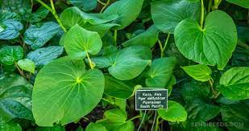
Kava
Derived from the Piper methysticum – smoked or used as a tea to relax or to treat anxiety
Exact mechanism of action is unknown
Symptoms are not expected to be severe enough to require intervention
Long term use may result in dermatitis, hepatotoxicity, indigestion, and nausea

Slide 41
Delta 8

Slide 42
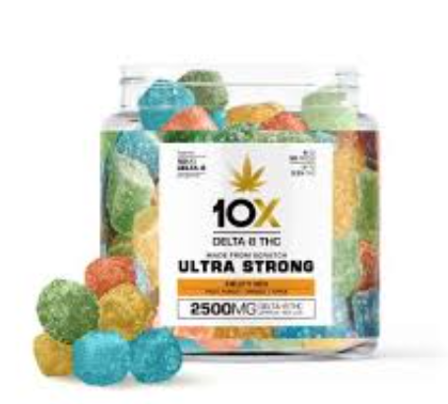
Delta 8
One of 100 cannabinoids
Manufactured from hemp derived CBD
Has psychoactive properties
Not approved or regulated by the FDA

Slide 43
Delta 8
Adverse effects include:
Hallucination
Vomiting
Tremor, anxiety, dizziness,
Confusion and loss of consciousness
Delta 8 Exposures Reported to APIC
Year | Exposures
2021 | 163
2022 | 140
2023 (YTD 9/24/23) | 187
Notes:
0-5: 64; 6-12: 26; 13-19: 24; 20-64: 65; 65+: 6 Unknown Adult: 2
ORAL: Tmax: 30 to 120 minutes and as late as 4 to 6 hours. ONSET: 0.5 to 2 hours. DURATION: 5 to 8 hours. BIOAVAILABILITY: 4% to 20%; high inter- and intra-patient
Hallucinations, vomiting, tremor, anxiety, dizziness, confusion, and loss of consciousness have been reported with delta-8-THC (FDA, 2022).

Slide 44
Questions?
1-800-222-1222

Slide 45
Ginger Parsons, RN CPN (205) 638-6287 ginger.parsons@childrensal.org

Slide 46
Evaluations/Contact Hours

Slide 47
Evaluations/Contact Hours
When you leave the webinar, you will be redirected to a survey. This is your evaluation for contact hours.
You will also receive an email with a direct link to the same evaluation tomorrow. This will be sent to the email address used during registration.
You only need to complete the survey ONCE. Upon completion, you will see a thank you message confirming your responses have been recorded.
Do not share this evaluation link with others.
Evaluations are due by noon on Monday, October 16, 2023.

Slide 48
Ginger Parsons, RN CPN (205) 638-6287 ginger.parsons@childrensal.org

Slide 49
Thank you for attending our School Nurse Spotlight!

