Slide 1
Caring For Insulin Pumps and Continuous Glucose Monitors at School
Melissa Ashdown BSN, CDE, CPT
G. Denise Cooks, MSN, CPNP-PC, CDE, CPT

Slide 2
Objectives
Understand the difference between Continuous Glucose Monitors and Insulin Pumps
Describe hyperglycemia and hypoglycemia
Identify causes of hyperglycemia and hypoglycemia
Discuss signs and symptoms of hyperglycemia and hypoglycemia
List treatment options for hyperglycemia & hypoglycemia

Slide 3
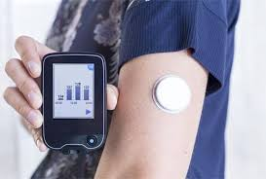
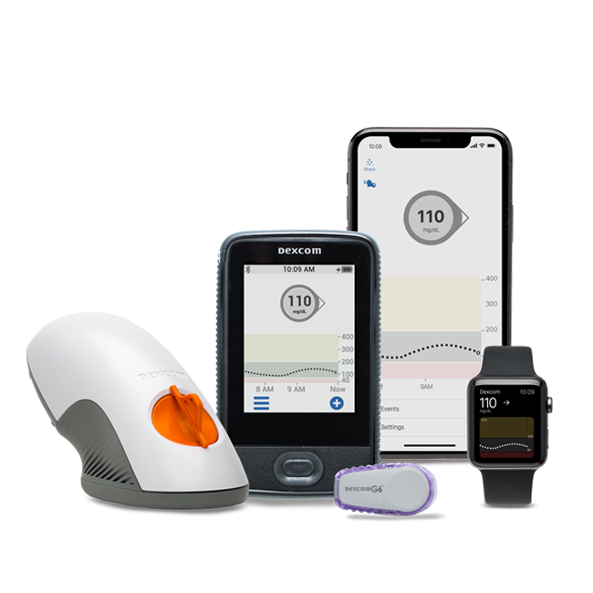
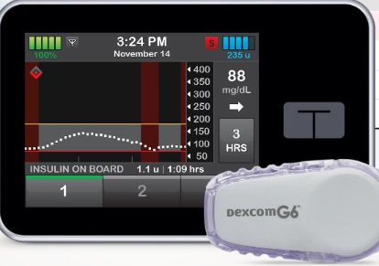
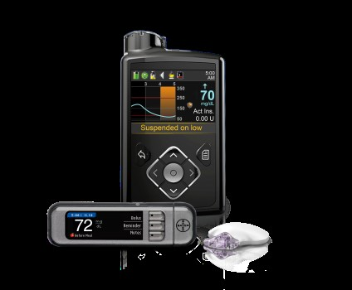
Continuous Glucose Monitor (CGM)
Freestyle Libre
Tandem t:slim X2 Insulin Pump with Dexcom G6 (Basal IQ Technology)
Dexcom G6
Medtronic Insulin Pump with the Guardian CGM

Slide 4
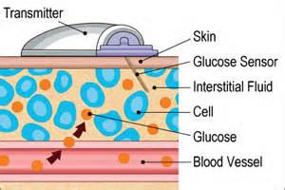
CGM Monitoring
Has a small sensor under the skin, that reads the glucose in the interstitial fluid
It is not a blood glucose
They will rarely read the same but should be within 20%
Provides real time sensor glucose reading values that are updated every 5 minutes (up to 288 times per day)

Slide 5
CGM Monitoring
Used as a tool to assist with blood glucose monitoring
Does not replace finger-stick for all models
Do not use CGM readings to treat low/high blood glucose
If the sensor glucose reads less than 70 or above 300 must confirm with a blood glucose finger-stick

Slide 6
CGM Monitoring
The medical management plan will have a check mark next to the CGM brand the patient is currently wearing
Refer to pages 4-5 of the medical management plan to determine if the sensor readings are able to be used for dosing
FDA has only approved dosing with a Dexcom G6
If using the sensor reading for dosing, you must enter the reading into the insulin pump for calculations to be completed

Slide 7
CGM Monitoring Scenario
Leslie comes to the health room complaining of a headache and she is pale. Her CGM reading is 56.
What is the next step?
Does she require a finger stick?
Notes:
Do a finger stick blood sugar to verify and then treat according to Diabetes Medical Management Plan.

Slide 8
CGM Monitoring Scenario
Mark comes to the health room before lunch. He is wearing the Dexcom G6 CGM and has the Omnipod 400 insulin pump. The readings before lunch on the CGM says 183.
Can you use this for dosing?
Does he require a finger stick?
Notes:
-Yes you can use this for dosing, but you must enter it in to his insulin pump for calculations to be completed.

Slide 9
CGM Monitoring Scenario
Anna comes to the health room before leaving school. She has the Medtronic 670G insulin pump and wears the Guardian sensor. On the screen of the insulin pump you notice the CGM reading is 152 with one arrow down.
Can you use this reading?
Does she require a finger stick?
Can she get on the bus?
Notes:
Yes, she would not require another finger stick. You can document the reading and allow her to board the bus.

Slide 10
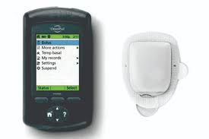
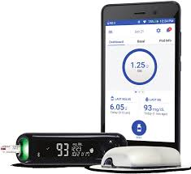
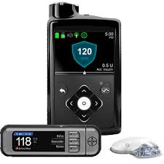
Insulin Pumps
Omnipod 400
Tandem t:slim X2 Insulin Pump with Dexcom G6 (Basal IQ Technology)
Omnipod DASH
Medtronic Insulin Pump with the Guardian CGM

Slide 11
Insulin Pumps
Deliver insulin very similar to how the normal pancreas does
Programmed to deliver basal and bolus doses
Uses only rapid acting insulin (Novolog, Humalog, Apidra)
The patient will always have a prescription for a long lasting insulin to be used in case of insulin pump failure
Notes:
Talk about how this is always on their discharge information

Slide 12
Understanding Basal Dosing
Basal Rate
Programmed to deliver a continuous flow of insulin in small increments throughout the day and night
This rate can be increased or decreased according to individual needs
Measured in unit(s) per hour continuously over 24 hours
Takes the place of long acting insulin

Slide 13
Understanding Bolus Dosing
Bolus
Given on demand
Covers carbohydrate intake for meals and snacks
Given to correct high blood glucose readings

Slide 14
Understanding Bolus Dosing
The insulin pump is programmed with the following individual settings to calculate doses based on food intake and blood glucose levels:
Target blood glucose
Insulin sensitivity or correction factor
Insulin to carbohydrate ratio
Active insulin time or insulin on board (IOB)
The pump takes all of these settings into account for bolus dose calculations

Slide 15
Active Insulin / Insulin on Board
It takes 3 – 4 hours for the body to use an entire bolus dose
The pump will remember how much insulin is still working in the body and will subtract this amount from the next bolus
This will prevent “insulin stacking” which could lead to hypoglycemia
Example:
Carbohydrate bolus 3 units
Correction bolus +2 units
Active insulin/ IOB -1 unit
Total bolus recommended 4 units
*This is why the calculations on the pump differ from yours*

Slide 16
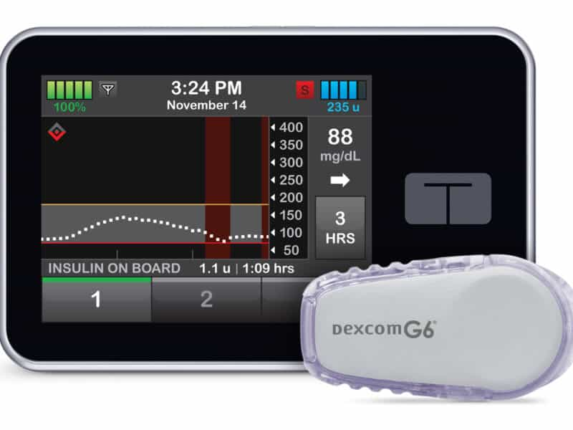
Insulin Pumps
Tandem t:slim X2 with Basal-IQ Technology
If using the sensor reading at the meal time enter the reading in the bolus screen for dosing
If sensor glucose below 70 or above 300 confirm with a finger-stick
Basal IQ - Predicts ahead 30 minutes, if the sensor glucose will be 80mg/dL or below
Suspends basal insulin to help avoid hypoglycemia
Resumes basal insulin automatically once glucose starts to rise
If Basal IQ is active at a meal time, you will have to cancel it before it will allow you to put in the blood glucose and carbohydrates for dosing
Basal IQ is only available if they are wearing the Dexcom G6
Notes:
Talk about how not everyone will have the CGM due to insurance.
Talk about how you cancel it at a meal time because when they start to eat the glucose should rise. You will do a finger stick and enter in the low blood glucose and the carbohydrates eaten for the math calculations to be completed. This is a time the patient can eat first then bolus right after eating. No longer than 30 minutes from the first bite of food.

Slide 17
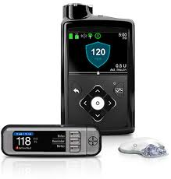
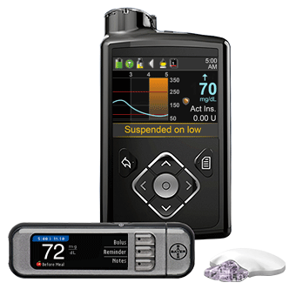
Insulin Pumps
Medtronic 630G and 670G with Guardian sensor
Guardian CGM is not FDA approved for meal time dosing at this time
Still needs a blood glucose check via finger-stick
Enter under Bolus Wizard
670G with AutoMode: (automatically adjusts basal insulin delivery every 5 minutes based on sensor glucose levels) if wearing the CGM
630G Safe Guard Feature: will suspend when the low limit is reached if wearing the CGM
CGM cannot be transmitted to a cell phone

Slide 18
Insulin Pumps
Omnipod 400 and Omnipod DASH
Omnipod 400: Integrated meter (Freestyle), Remote bolus from Personal Diabetes Monitor (PDM) within 5 feet, No tubing
Omnipod DASH: Touch screen (PDM), Rechargeable battery - charge daily (PDM), Contour Next One blood glucose meter, Food library with more than 80,000 food items, No tubing
Not integrated with any CGM at this time. If the patient is wearing a CGM that can be used for dosing, you must enter it in the bolus calculator for correct calculations to be completed
Notes:
Talk about how the DASH is new and due to insurance it may be a while before this insulin pump is seen

Slide 19
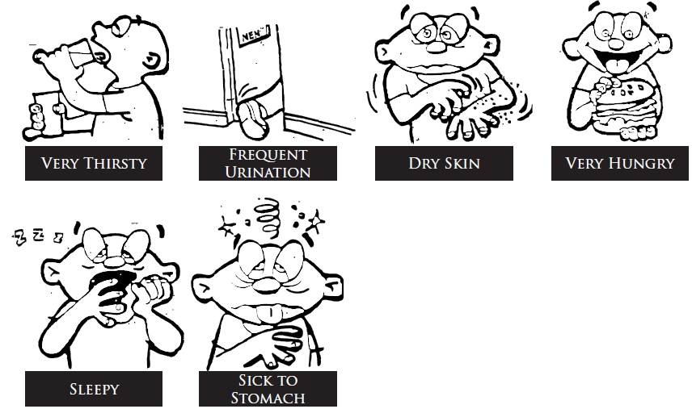
Hyperglycemia Symptoms

Slide 20
Hyperglycemia
Causes of Hyperglycemia
Illness
Underestimated carbohydrates and bolus
Pump cartridge/reservoir empty
Cannula kinked/occluded under the skin
Insulin pump malfunction
Leak in the infusion set tubing
Stress
Low batteries
Insulin is old/hot
Other medications
Forgot to bolus
Not rotating pump sites
Infusion set/Pod has exceeded 72 hours

Slide 21
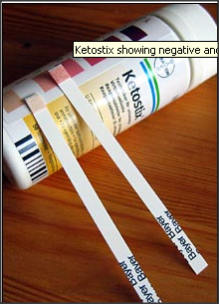
Hyperglycemia
Check for ketones if blood sugar if greater than 250mg/dl and/or student complains of nausea/vomiting, stomach ache, or is feeling ill
Students should have access to water
  May be added to 504 plan
Students are not to miss class by sitting in the nurses’ office or sent home- unless nausea/vomiting or feeling ill
Refer to page 6 of the Medical Management Plan for hyperglycemia treatment when using an insulin pump

Slide 22
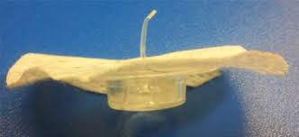
Hyperglycemia
A common cause of hyperglycemia is an occluded/bent cannula
People wearing insulin pumps can develop diabetic ketoacidosis (DKA) within 4 hours if there is a problem with the delivery of insulin from the insulin pump
Remember…NEVER disconnect or suspend the insulin pump for longer than one hour

Slide 23
Treatment of Hyperglycemia for Insulin Pump Therapy
When wearing an insulin pump a correction bolus can be given every 2 hours if needed to treat hyperglycemia, and to help get ketones out of the body
The insulin pump has an Insulin on Board/Active Insulin feature that will prevent stacking insulin doses
Check for Ketones with every void if blood glucose above 250
Notes:
IOB – Will not allow pump to give more insulin than student needs.
Pump will subtract from total dose if active insulin is still on board in the body.
The active insulin time is programmed in the insulin pump.

Slide 24
Treatment of Hyperglycemia for Insulin Pump Therapy
  If the student has 2 consecutive blood sugar readings greater than 250mg/dl and there is no reasonable explanation:
    The student will need to change the pump infusion set/Pod, and use new insulin
    If the student can not do this independently, call the parent
    This could be a sign of a bad insulin pump site
Notes:
Talk about the purpose of giving a pen injection instead of just changing out the pump site

Slide 25
Treatment of Hyperglycemia for Insulin Pump Therapy
Loss of Infusion Site: (Marked independent)
Refer to page 5 of the Medical Management Plan
Remove the insulin pump site/pod
Independent students with supplies may reinsert infusion set
Recheck blood glucose in two hours to ensure proper placement
Notes:
IOB – Will not allow pump to give more insulin than student needs.
Pump will subtract from total dose if active insulin is still on board in the body.
The active insulin time is programmed in the insulin pump.

Slide 26
Treatment of Hyperglycemia for Insulin Pump Therapy
Loss of Infusion Site: (Not marked independent)
Refer to page 5 of the Medical Management Plan
Remove the insulin pump site/pod
Notify caregivers to see if they are able to administer long acting insulin or if they can come to the school to replace the pump site
If you have their long acting insulin you may administer it (Give as immediately as you can)
If you do not have long lasting insulin, or the family is unable to come to the school then you can begin manual insulin injections by syringe or pen
Notes:
IOB – Will not allow pump to give more insulin than student needs.
Pump will subtract from total dose if active insulin is still on board in the body.
The active insulin time is programmed in the insulin pump.

Slide 27
Treatment of Hyperglycemia for Pump Therapy
Manual Injections:
If you have to administer rapid acting insulin via syringe/pen due to a bad site or insulin pump failure
Carbohydrate ratio and correction factor doses will be the same on the prescriber authorization form (You can continue to use the same form)
Remember you must wait 3 hours between correction dose administration while on injections
Give meal dose as scheduled

Slide 28
Treatment of Hyperglycemia for Insulin Pump Therapy
For Pump Failure:
  Remove pump and resume insulin injections by syringe or pen
  Rapid acting insulin may be administered by syringe/pen injection for insulin to carbohydrate ratio and correction factor doses
  Refer to the Prescriber Authorization form for dosing
  Remember: No insulin on board with injections, must wait 3 hours between correction doses
  Notify caregiver so (long acting insulin) can be administered if possible
  Do not allow student to “graze”
  Meal doses may be given as scheduled
  No need for student to go home, unless moderate to large ketones with nausea and/or vomiting
Notes:
Stress MUST wait 3 hours between correction factor doses when going back to injections.
Stress can use the same Prescriber Authorization form

Slide 29
Treatment of Hyperglycemia for Pump Therapy
  Moderate to Large Ketones with Nausea and Vomiting:
  Give correction bolus using insulin pen/syringe
  Remember to input bolus into pump for insulin on board – do not give bolus to the patient through insulin pump
  Run bolus into the trash (For Insulin on Board)
  Student will need to change infusion set, site/pod and refill with new insulin; call parent if student cannot do this independently
  This child should go home
  If you cannot get in touch with the parents contact our diabetes doctor on-call for pump calls: 205-638-9107 or after hours 205-638-9100

Slide 30
Scenario
Grant’s diabetes is managed by an insulin pump. His current blood sugar is 278. His last correction bolus was 2 hours ago. When can he have another correction bolus?
Notes:
He can have one now with an insulin pump due to the IOB feature

Slide 31
Response
Correction bolus can be given now
Insulin pumps have insulin on board feature, which calculates to prevent the stacking of insulin doses

Slide 32
Scenario
Eli comes to you from the playground after being tackled by another student. The screen on his insulin pump is shattered and the pump is not delivering insulin. How should you proceed?
Notes:
Call the family to inform them
Start using the patients rapid acting insulin and can only give correction every three hours as needed
Call family to give Long lasting insulin dose if possible.

Slide 33
Response:
Remove pump
Notify caregiver so long lasting insulin can be administered
Rapid acting insulin may be administered using syringe or pen for insulin to carbohydrate and correction factor doses
Correction doses must be given 3 hours apart, but meal doses may be given as scheduled
Student does not need to go home

Slide 34
Scenario
Karen ate lunch at 12:15pm. Her blood sugar was 148 and she received a correction dose at that time. It is now 1:45 pm and the class is having a party with pizza and ice cream.
Can the student participate in the party?
Can she get insulin for the party food?
Does she need to check another blood glucose?
Notes:
Yes they can participate and get insulin for the party food.
Remember, they get rapid acting insulin for carbs as often as they eat.
If needed, contact the office for a special snack ratio for parties if the student does not already have a snack ratio

Slide 35
Response:
Yes the student can participate and get insulin for the food eaten at the party
Remember students can get rapid acting insulin for carbohydrates as often as they eat
No need to check a blood glucose since it has not been two hours since the last correction was given
You will only enter in the carbohydrates to be eaten

Slide 36
Symptoms of Hypoglycemia

Slide 37
Hypoglycemia on Insulin Pump
Causes of Hypoglycemia
  Miscalculated carbohydrates
  Too few carbohydrates consumed for the amount of insulin given
  Basal rate set too high
  Exercise or unusually high activity

Slide 38
Treatment of Hypoglycemia for Insulin Pump Therapy
Treatment of Mild Low Blood Sugar
Refer to page 8 in the Medical Management Plan
Rule of 15
If blood glucose is still below age specified range after first treatment retreat with 15 grams fast acting sugar and suspend the insulin pump
Recheck blood glucose in 15 minutes
Repeat steps until blood glucose is above age specified range
Once blood glucose is above age specified give 15 grams carbohydrate snack with protein
Remember to resume pumping

Slide 39
Treatment of Hypoglycemia for Insulin Pump Therapy
Treatment of Low Blood Sugar at Lunch
If blood sugar is greater than 60mg/dl, bolus may be given after lunch
Bolus must be given within 30 minutes of the first bite
Make sure to enter in the low blood glucose number for calculations
Insulin pump adjusts carbohydrate bolus to compensate for low blood glucose
Do not skip insulin bolus for low blood sugar!

Slide 40

Treatment of Hypoglycemia for Insulin Pump Therapy
Treatment of Moderate Low Blood Sugar
Suspend insulin pump
Keep head elevated and give cake decorating gel or instant glucose gel applied between cheek and gum
Rule of 15
Once blood sugar is above age specified range, give 15-30 gram carbohydrate snack or meal plus protein
Remember to resume pumping when blood sugar is above age specified range

Slide 41
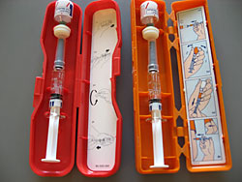
Treatment of Hypoglycemia for Insulin Pump Therapy
Treatment of Severe Low Blood Sugar
Immediately suspend/remove insulin pump!
Give nothing by mouth
Place student on side
Give glucagon/glucagen as directed
Follow your school’s procedure in regards to calling 911
Call parent and then physician
Stay with student until help arrives

Slide 42
Exercise and Pump Therapy at School
Temporary basal rate is a special feature that can be set to temporarily give less basal insulin to prevent hypoglycemia with physical activity
It is set in a percent and a duration
Some patients who experience hypoglycemia after P.E. will benefit from this feature
The family can request a form that is signed by their provider

Slide 43
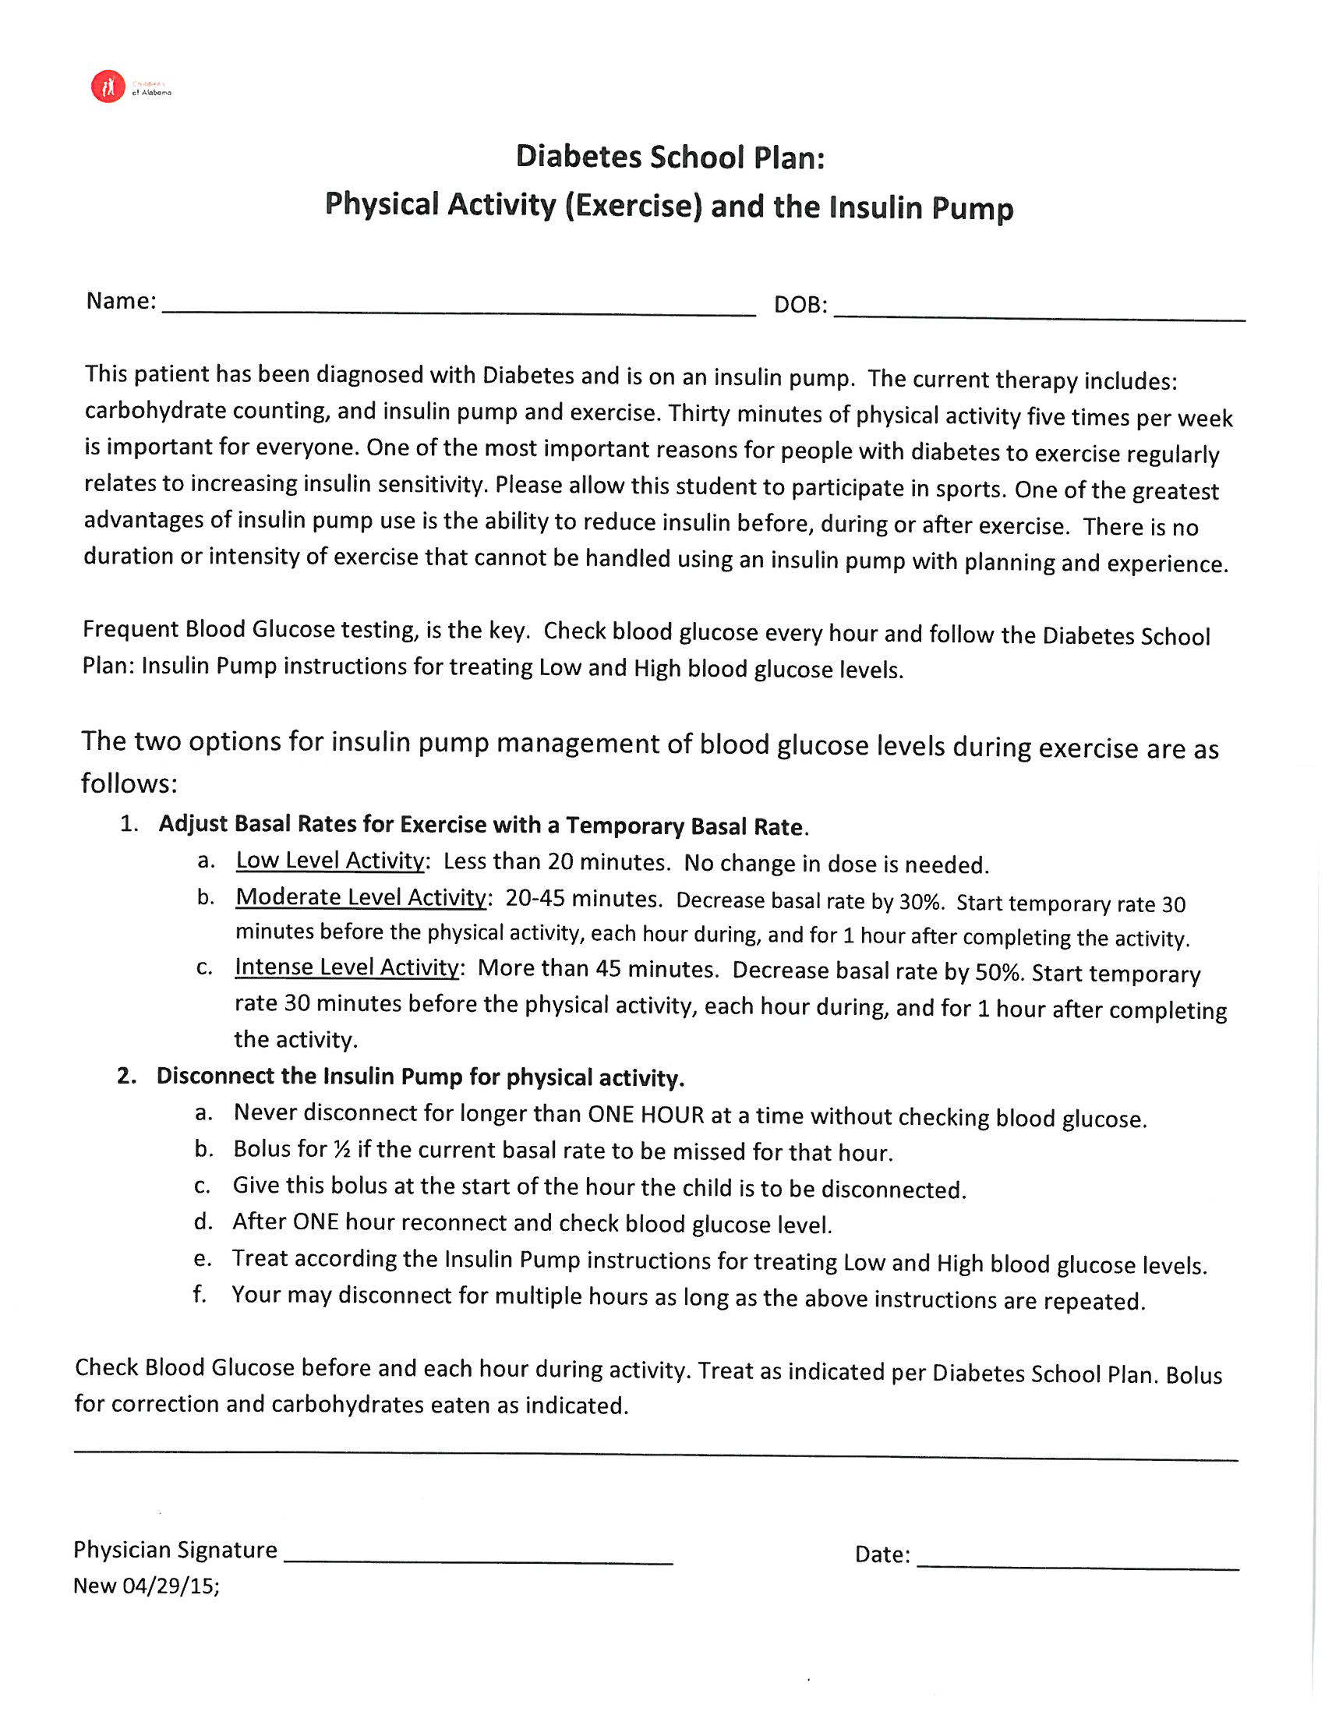
Exercise and Pump Therapy at School
Please request this form
if you have a student on an insulin pump that participates in physical activity.

Slide 44
Scenario
Sam has baseball workouts for approximately 45 minutes. What type of temp basal would you set and what steps would you take to set one up?
Notes:
Set up temp basal, talk about “Temporary basal rate”
Talk about how some pumps start at 100% others 0%

Slide 45
Response
A Temp Basal Decrease would be used
Due to Moderate Activity of 20-45 minutes, set a temp basal decrease by 30%
Start the temp decrease 30 minutes prior to the activity and so that it will run for the entirety of the activity plus one hour after to help prevent hypoglycemia
Request the temp basal physical activity form

Slide 46
Scenario
William an 8 year old boy came to the nurses lounge before lunch. Upon checking his blood glucose was 72. He did not feel symptomatic. What is the next step you should take?

Slide 47
Response
Since he is asymptomatic he should go to the lunchroom
Administer insulin immediately after eating (No longer than 30 minutes)
Make sure to input the “low” blood glucose number and carbohydrates eaten into the insulin pump for calculations

Slide 48
Scenario
Millie a 6 year old student comes to your office with an aid. She is dizzy, pale, and sweaty. You check her blood glucose via finger-stick and she is 58. You gave her 4 glucose tablets and rechecked her blood glucose in 15 minutes. At this blood glucose check she was 61. What is the next step you should take?

Slide 49
Response
Suspend her insulin pump
Give her 15 grams of a fast acting carbohydrate
Recheck her blood glucose in 15 minutes
If back above her age specific range then resume the insulin pump
Follow up with a snack

Slide 50
Conclusion
If Questions or Concerns:
Call Children’s of Alabama Diabetes Team
205-638-9100 (On-Call MD)
205-638-9107 (Diabetes office)

Slide 51

Questions?

