Slide 1
Caring for the Diabetes Patient
At School:
Skills in Diabetes Management
Notes:
Questions will be answered at the end of this session. However, please hold all SP/DMMP questions until the SP session.

Slide 2
Presenters
Becky Earman RN, CDE
Leah Black BSN, CPN
Sheila Benton BSN, CDE
Jeri Lynn Gehri BSN, CPN, CDE

Slide 3
Objectives
At the end of the session, the participants will have:
Reviewed skills for:
  Monitoring blood sugars
  Monitoring ketones
  Giving injections
Reviewed insulin and calculating insulin doses
Reviewed sample scenarios
Notes:
Today we are going to review diabetes skills. You may have newly diagnosed students and those who have had diabetes for years. These students will be in various points along the spectrum from total care by you to independent. We want you to know what we teach families so you can assist us and their parents/caregivers in helping the student as needed. Our other goal is to ensure the same information is given and we all are instructing the students the same.

Slide 4
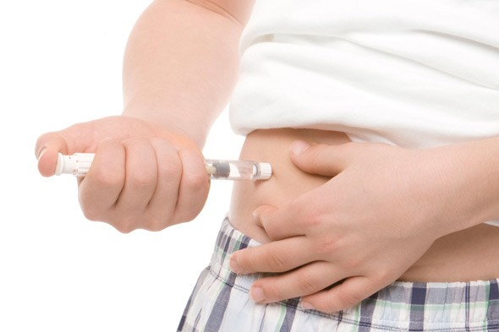
Injection with Insulin Pen
IntReviews.com
Notes:
The first review will be on insulin injections. We will focus on insulin pens as most of our patients use the pens for their injections. We will discuss the injection technique with no skin pinch first since most students will be using the 4 mm (green tip) pen needle. We will then review the technique for insulin injection with a skin pinch and when to use this technique. You will notice positioned around the room some other diabetes educators who will demonstrate each injection technique as we discuss each slide.

Slide 5
Insulin Injection with Insulin Pen
Make sure you are giving the correct insulin
  If giving both rapid and long acting insulin at school, verify dosage and insulin immediately before each injection
Have all supplies: insulin, pen needles, 2 alcohol pads
Remove cap off insulin pen
Clean the rubber stopper on the end of the insulin pen with alcohol pad
  Do not put insulin pen down once it has been cleaned with the alcohol pad
Open pen needle, insert onto the rubber stopper end of insulin pen-straight on-not at an angle-so you do not bend the needle, twist until resistance is met
Remove the clear cap (save this piece) and the colored cap (throw this one away)
  The colored cap only signifies the size of the pen needle- each size is a different color
Notes:
If family provides limited alcohol pads and you only have enough for 1 pad per injection always clean insulin pen first before cleaning the skin.
If families do not bring enough supplies, follow your chain of command.

Slide 6
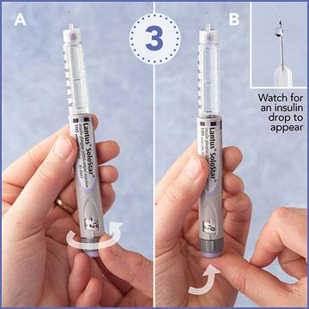
2 Unit Air Shot
The 2 unit air shot is to clear air from pen needle and any air bubbles in the insulin pen so the student gets the full dose of insulin.
  Turn the dial to 2 units, hold the pen with needle pointing straight up
  Tap the side of the pen to move any air bubbles up to the top of the insulin
  Press the plunger until dial returns to zero
  www.diabeticlivingonline.com

Slide 7
2 Unit Air Shot
Does insulin come out? If yes, count to 5 keeping pressure on the plunger while you count
  Tap insulin pen to remove any insulin drops on the end of the needle.
If no, repeat these steps until insulin comes out.
  The first injection with a new insulin pen/cartridge may require several attempts at the air shot before insulin is seen from the tip of the needle
Change to a new pen needle if no insulin is seen after several attempts as the needle may be occluded. Especially if it is not the first time this device has been used for an injection.
The 2 unit air shot is repeated with every injection because a new pen needle is used with each injection.
  If this step is not done with each injection, the student is not receiving the full dose of insulin.
  Everyone is instructed to use the 2 unit air shot, there will never be a reason to skip this step

Slide 8
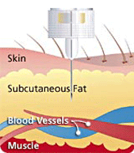
Insulin Pen injection with No Skin Pinch
Turn dial to calculated dose (shown in dosing window)
Clean injection site with alcohol pad
  Hold pen with dosing window facing you to see that it goes back to zero
Inject at 90 degree angle into subcutaneous fat
www.bd.com

Slide 9
Insulin Pen injection with No Skin Pinch
Push plunger button down, dosing window should go back to zero. Once it is back to zero, continue to hold button down and count slowly to 10
  If leak back is noted consistently, count to 15
Pull needle out at same 90 degree angle
  If bleeding occurs, do not rub the site, hold light pressure until bleeding has stopped
  Rubbing the site could cause insulin to absorbed more rapidly which could lead to hypoglycemia
Replace clear cap only
Remove pen needle and place in sharps container
Usually no skin pinch technique can be used if using a 4mm or 5 mm pen needle

Slide 10
Insulin Injection with Skin Pinch
A skin pinch for the injection is needed if:
  Using a 6 mm or larger pen needle
  Student is younger than 6 years old even if using a 4mm or 5 mm pen needle
  Student is very thin, regardless of age and size of pen needle being used
Previous steps remain the same until you are ready to inject into the skin
Prior to inserting the needle into the skin, pinch a 1 to 2 inch portion of skin and fat between thumb and first finger.
Insert needle into the skin at a 90-degree angle
Let go of the pinch once needle has fully been inserted into the skin
Inject the insulin dose and count to 10
Remove needle at same 90 degree angle
  www.diabeteseducator.org
Notes:
Thank you to the educators who assisted in demonstrating the injection techniques.

Slide 11
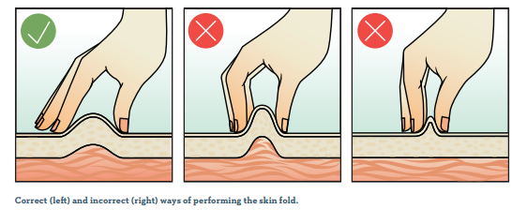
Notes:
Picture of the correct skin pinch size.

Slide 12
Insulin injection sites
Arm (back of the arm-the fatty part- not the side)
Abdomen (injection to be 2 inches away for navel/belly button)
Thigh
Hip area (can be used but school age children do not have to use this area)

Slide 13
Injection Site Rotation
Site Rotation
  To be done with each injection
  Prevents lipohypertrophy (insulin knots/scar tissue caused by repeated injections in the same place)
  At first will only feel the knotty area but as it worsens you will be able to see the raised, lumpy area
  Hyperglycemia usually occurs if continue to give injections in
  knotty areas as insulin will not absorb as it should in these areas
    This is why making sure they are rotating injection sites is so important
  Also rotate within each site. Each injection to be 1 inch
  above or below or to the side of the previous injection in each site
Notes:
Stress avoiding using the same area for each injection

Slide 14
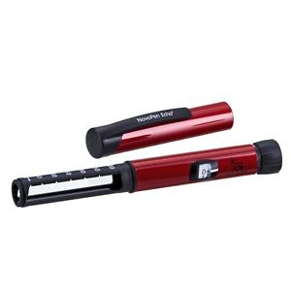
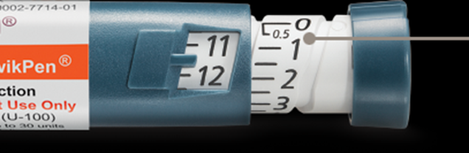
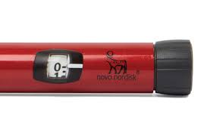
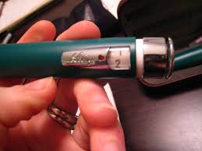
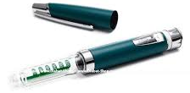
Half Unit Insulin Pens/ Pen Devices
Humalog Junior KwikPen with Half-Unit Dosing (Disposable)
NovoPen Echo
HumaPen LUXURA HD
www.novolog.com
www.lilly.com
Notes:
Some of your younger students may use half unit insulin pens/pen devices. This allows dosing in half unit increments instead of whole unit increments.

Slide 15
Half Unit Insulin Pens/Pen Devices
Humalog
  Humalog Junior KwikPen is a disposable half unit pen.
  Humalog Luxura uses Humalog cartridges only.
    Has 3 pieces that are reusable- only the cartridge is removed and disposed of.
Novolog
  NovoPen Echo uses Novolog cartridges.
    Also has 3 reusable pieces with only the cartridge being removed and disposed of.
  Must pull out the black knob on the end of the device to be able to dial insulin dose
  End of device will show dose and time of last injection
Notes:
Cartridges are not interchangeable between devices

Slide 16
Care and Storage of Insulin
Un-open insulin is kept in the refrigerator until ready to be used
  It is good until the expiration date on the insulin pen, as long as it has been refrigerated and not opened
    Insulin is considered opened once a pen needle has been inserted into the rubber stopper
  Once open it may be kept at room temperature (86 degrees or less, away from heat and light) for 28-30 days
  If using a Humalog Luxura or NovoPen Echo insulin pen device with cartridge, do not place the pen device in the refrigerator
All insulin should be clear. If not, dispose of the disposable pen or the cartridge and a new insulin pen/cartridge must be used.
Notes:
Due to the increasing constraints of insurance, your student may not have an insulin pen to leave at school. They may have to transport it from home to school and back daily. Unfortunately, this is out of our control.

Slide 17
Rapid Acting Insulin
Novolog (Aspart) U-100
  Fiasp U-100
Humalog (Lispro) U-100; U-200
Apidra (Glulisine) U-100
  Rapid acting insulin begins to work 10-15 minutes after the injection
    Fiasp begins working in 5-8 minutes after injection
  Rapid acting insulin works best if given before the meal/snack
    If given after the meal, it should be within 30 minutes of first bite of food
  Works hardest 30 - 90 minutes after the injection
  Lasts in the body approximately 4-6 hours
Notes:
Fiasp is a new form of Aspart, it was developed to start working faster
Currently there are several patients using this medication.

Slide 18
Scenario 1
Student’s lunch blood sugar was 118. They received their meal dose of rapid acting insulin and went to lunch.
1 hour later they return to your office stating they do not feel good. Blood sugar is 490.
What do you do?
Do not give a correction factor dose. Meal dose is still working .
Check for ketones
Encourage them to drink water
Send back to class with water
If you feel the student is to ill to stay at school call the parent/caregiver
Notes:
Remember rapid acting insulin works its hardest up to 90 minutes after injection.
High reading could be due to several different things. You can try to trouble shoot to see if student ate additional food that was not covered, was it a high fat food, is student becoming sick, etc.

Slide 19
Dosing Rapid Acting Insulin
Insulin is dosed for meals and snacks (if ordered) with rapid acting insulin by either an insulin to carbohydrate (carb) ratio or a set (fixed) dose
  A example of insulin to carb ratio:
    1 unit Novolog for every 15 grams of carbohydrates
  A example of set or fixed dose
    5 units Novolog for lunch
A high blood sugar is corrected or fixed by either a correction factor or a sliding scale
  A example of correction factor
    Blood sugar -150 /75 (150 is the target BG; 75 is the insulin sensitivity: 1 unit will lower BG about 75 points)
  A example of a sliding scale
    150-200 = 1 unit, 201-250=2 units, etc
Notes:
ICR/CF is used most often as this is as close to what the body would do naturally
Other dosing is used when families either cannot or will not calculate doses
Some students will use ICR/CF at school and use S/SS at home. If the student is old enough, you may be asked to help them learn to use the ICR/CF .

Slide 20
Dosing Rapid Acting Insulin
A combination of meal dose and blood sugar dose if needed will be used to calculate the insulin dose:
  Insulin to carbohydrate ratio + correction factor
  Insulin to carbohydrate ratio + sliding scale
  Set(Fixed) dose + correction factor
  Set(Fixed) dose + sliding scale

Slide 21
Rounding with Calculations
  If a carb ratio and/or correction factor is ordered you will also be given orders on how to round after getting the final answer:
  Round down to nearest whole unit
  Round down to nearest half unit
  Round up to nearest whole unit
  Round up to nearest half unit
  Round to nearest whole unit
  Round to nearest half unit
Notes:
If the rounding portion of the insulin order is not circled, please contact the diabetes office for a corrected order.

Slide 22
Sample Calculation
Insulin to carbohydrate ratio and correction factor
  Blood sugar = 245
  Carbs to be eaten = 48 grams
  Insulin to Carbohydrate Ratio is 1 unit fast acting insulin for every 20 grams carbohydrates
  Correction factor is blood sugar -150/65
  Round to nearest whole unit
  It does not matter which problem you work first
  Keep the answer to each calculation to the tenth place ( i.e. 4.6432= 4.6) (do not round yet)
  Once you have the answer to both problems, add them together to get the final answer
  Now you round as ordered
  Let’s now work this sample calculation together.

Slide 23
Sample Calculation
Correction factor (blood sugar -150/65):
  245-150/65
  245-150= 95
  95/65 = 1.4 (do not round yet)
Insulin to carbohydrate ratio:
  1 unit rapid acting insulin : 20 grams carbohydrates
  48 /20 =2.4 (do not round yet)
Final answer:
  Add 1.4 + 2.4 = 3.8 = 4 units
If you had rounded each answer separately then their dose would
have been 3 units and the student would be short 1 unit-possibly
resulting in a high blood sugar at the next check
Final answer:
1.4 + 2.4 = 3.8 = 4 units
Notes:
It is important to wait until final answer before you round
Additional sample calculations are in the DMMP

Slide 24
Sample Calculation
Set/Fixed Dose and Sliding Scale
Lunch blood sugar is 354
Lunch dose is 6 units
Sliding Scale:
  150-250 = 1 unit
  251-350 = 2 units
  351-450= 3 units
  451 or > = 4 units
6 units(lunch) + 3 units (high blood sugar)= 9 units
No rounding required

Slide 25
Long Acting Insulin
Lantus (Glargine) U-100
Basaglar (Glargine) U-100
Toujeo (Glargine) U- 300
Tresiba (Degludec) U-100 or U-200
Levemir (Detemir) U-100
  Long acting insulin is designed to be a slow release of insulin over approximately 18 - 42 hours, with most lasting approximately 24 hours
  It will be working when there is no rapid acting insulin available
  Usually given once daily at the same time
Notes:
May be given at school, usually lunch, if there is concern the student is not getting this insulin dose at home
Missing long acting insulin is one of the fastest ways for them to make ketones and to develop DKA.

Slide 26
Scenario 2
Jared receives Lantus 10 units by the nurse at lunch time.
The prescription label states 15 units TDD (total daily dose)
Do you need an updated prescription label to match the insulin order before you can give him his Lantus dose?
No, you are covered by the Lantus order for 10 units.
The dose on the pharmacy label includes the 2 unit air shot and rounding up to allow for dose increases as needed based on blood sugars.
This extra tries to ensure they do not run out at the end of each month or 90 day period depending on their insurance.
The insulin prescriptions are usually written for 1 year.

Slide 27
Scenario 3
Sam keeps his Basaglar with him and brings it from home daily
He comes to your office at lunch to give his dose. You note the insulin is cloudy.
What do you do?
You will not use this pen for his Basaglar dose.
Notify the caregiver. If possible, they will bring a new Basaglar pen so the dose can be given as close to on time as possible.
He can stay at school.
You will give correction factor every 3 hours as needed until he receives his Basaglar or goes home.
Contact the diabetes office, if needed, to help get Basaglar back on schedule.

Slide 28
Monitoring Blood Glucose
Hands should be clean and dry
  Soap and water is best, but can use alcohol pad or non alcohol based hand sanitizer
Place a test strip in the meter
Stick finger – on the side of the finger, close to the tip –not in the middle of the fingertip or the pad of the finger
  New lancet with each finger stick
  If having difficulty getting a good drop of blood:
    Wash hands in warm water if hands are cold
    Shake hands to warm them up if cold
    “Milk” the finger before sticking the finger with the lancet device
    Be sure lancing device is set for the correct depth
Touch test strip to blood
View and record results
  Develop plan with parent/caregivers for you to send them
  school blood sugars
Notes:
(READ FIRST BEFORE SLIDE) I know many of your students may now be using a CGM. CGM’s will be discussed in the next session. For now, we will focus on students who are still using finger sticks.
(after last comment re: plan– it is important for caregivers to know the readings from school. Ideally at least once a week they should get the readings; more often for highs and/or lows)

Slide 29
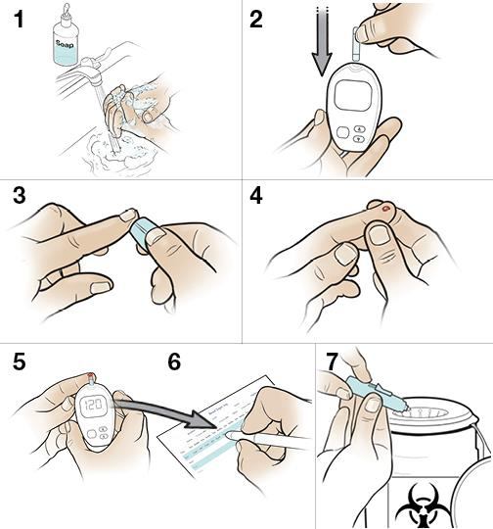
https://baycare.org/health-library/health-encyclopedia/2015/08/14/21/29/stepbystep-checking-your-blood-sugar
Notes:
Shows correct technique using the side of the fingertip

Slide 30
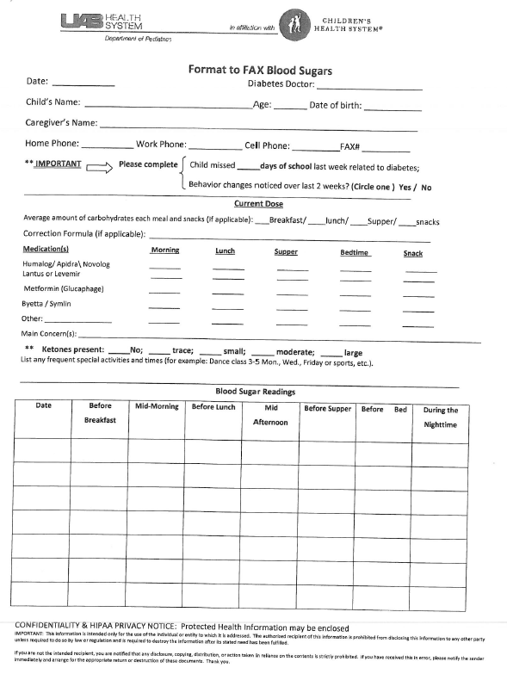
Format to Report Blood Sugars
Notes:
We ask blood sugars be reported in this format. Either form is acceptable. A legible copy of the log book is also acceptable as long as the log book is in this format.
We can easily determine patterns and if adjustments are needed. Unfortunately the generated forms we sometimes receive are not in the correct format and usually are not legible.

Slide 31
Format to Report Blood Sugars

Slide 32
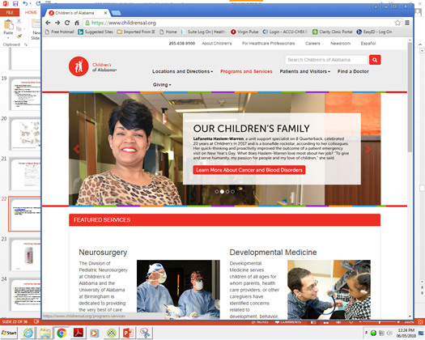
Steps to Print Log Sheet from Website
To find a copy of the log sheet to fax in blood sugars go to:
www.childrensal.org
Choose Programs and Services
Notes:
You have a copy of our log sheets in your folder.
You can also print off copies of the log sheet from the COA website using the step outlined in this PPT.
This can also be faxed to you if needed.

Slide 33
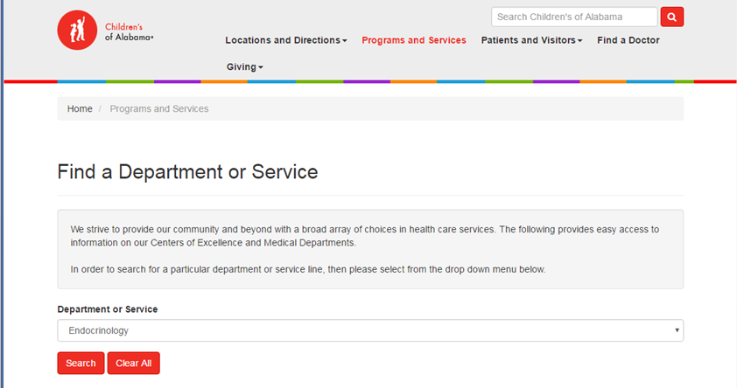
Steps to Print Log Sheet from Website
Then choose Endocrinology in the search box:
Then click on search

Slide 34
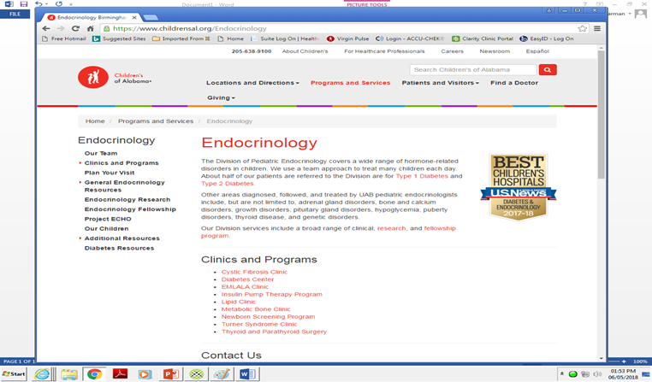
Steps to Print Log Sheet from Website
Click on Type 1(in red) in the first paragraph.

Slide 35
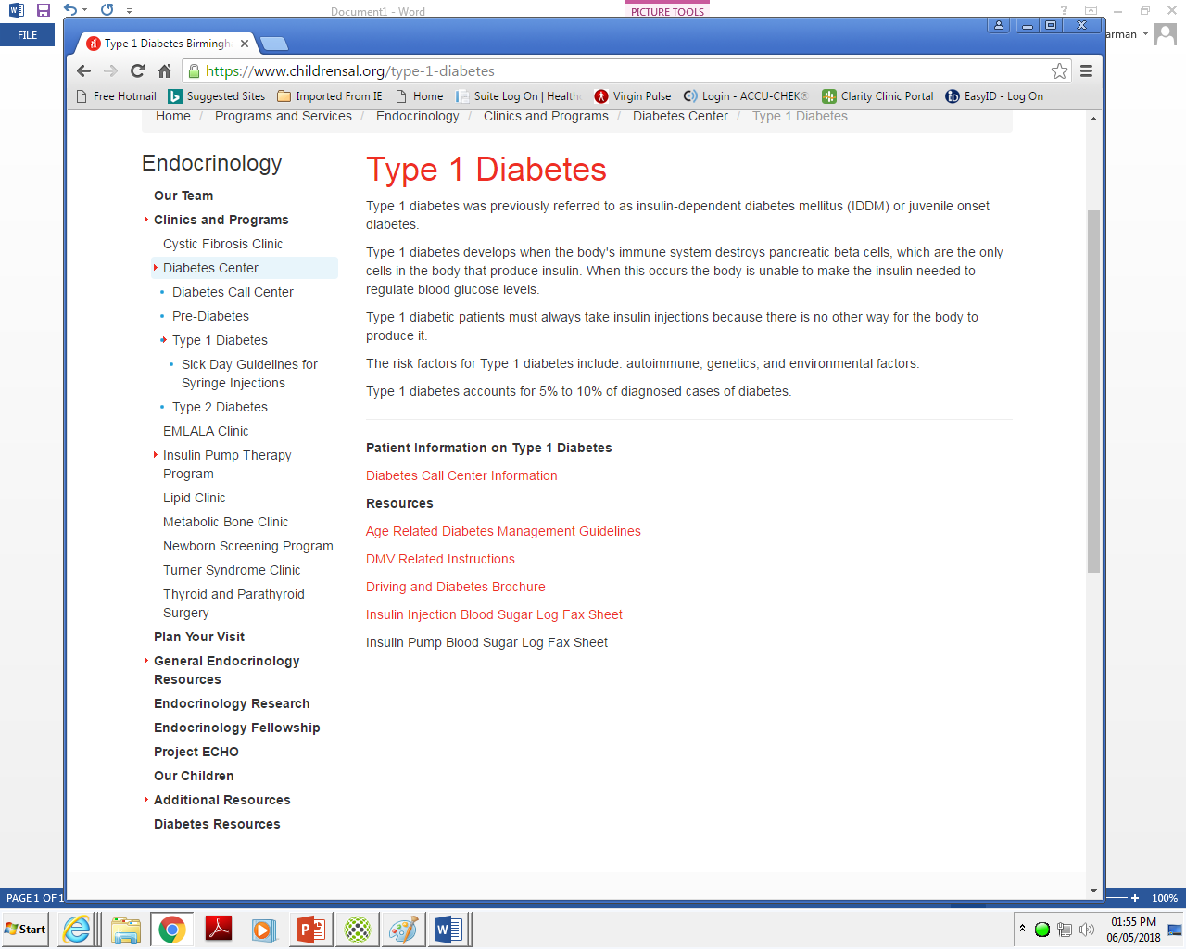
Steps to Print Log Sheet from Website
On this screen you scroll down and under Resources you select Insuli Injection Blood Sugar Log Fax Sheet.

Slide 36
Reporting Blood Sugars
When possible, it is best if you send the school readings home to the parent/caregiver so they can report home and school readings at the same time.
However, if you are seeing patterns or have concerns with blood glucose levels during the school day, fax/call in readings using the log sheet previously shown (or one in the same format), also send a copy home with student so the parent/caregiver is aware.
Please include your fax number (if your fax is not working please give your lead nurses’ fax number so updated insulin orders may be faxed to you if needed).

Slide 37
Scenario 4
We have received blood sugars on a student and changed their lunch ratio.
Your school fax is currently not working.
How will you get the updated insulin orders?
We can fax or email them to the parent/caregiver
Fax orders to your lead nurse
We cannot email the orders directly to school nurses

Slide 38
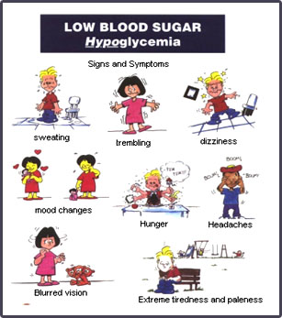
Hypoglycemia
www.drugline.org
Notes:
Shaky is the most common symptom. Students may describe this feeling differently (stomach feels like jell-o, legs feel like spaghetti noodles, etc.) They also may just say they do not feel good.

Slide 39
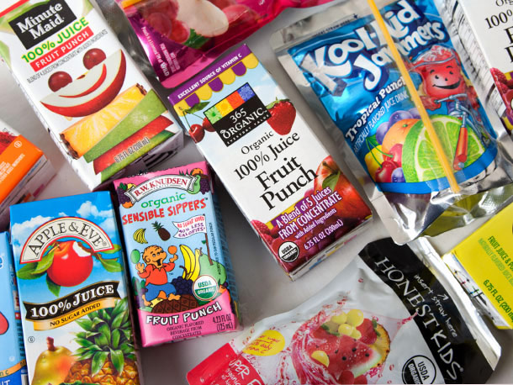
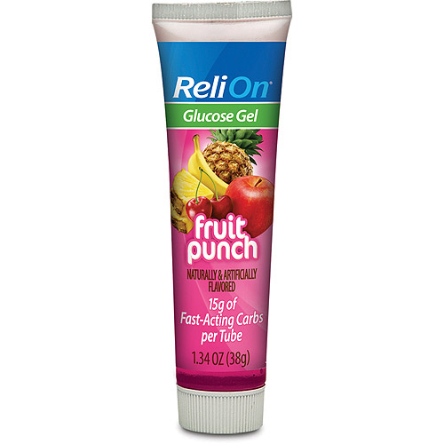
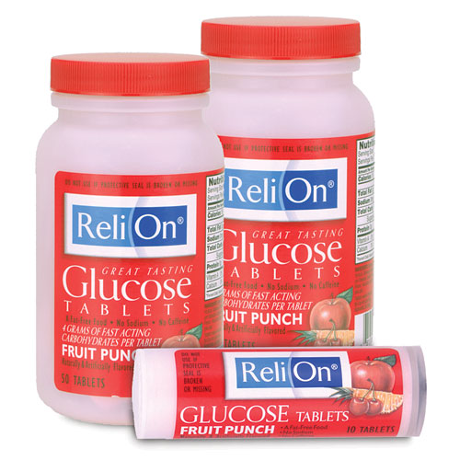
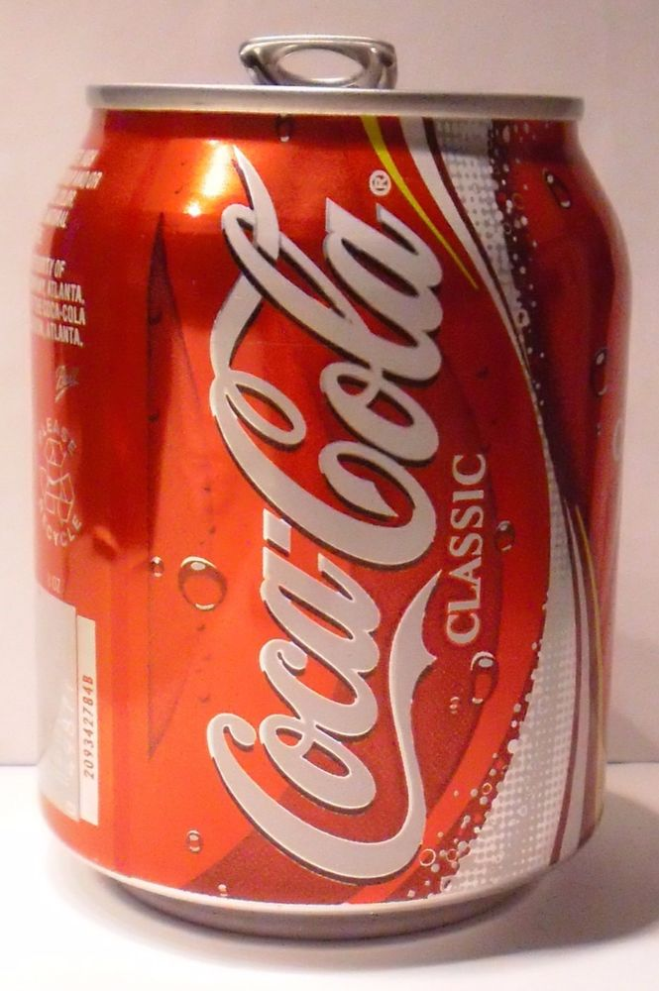
Hypoglycemia Treatment- Fast Acting Carbohydrates
Drinks.seriouseats.com
www.walmart.com
www.ebay.com
Notes:
Some students may bring cake gel instead of glucose gel. If it is 0.68 ounces they will get the whole tube if used to treat a low.

Slide 40
Hypoglycemia Treatment
Pick one of the fast acting carbohydrates up to 15 grams of carbohydrates
Wait 15 minutes
Recheck blood sugar
  If still low, based on age related guidelines in Diabetes Medical Management Plan, continue to treat with fast acting carb until student is back in target range (can use a different treatment if students wants)
If student will eat a meal or snack within next hour, they do not need a long acting carbohydrate snack
  If it will be longer than 1 hour before student will eat next meal or snack, give a 15 gram long acting carbohydrate snack
    4 peanut butter or cheese crackers
    Half of a sandwich
    8 ounces milk (not skim milk)
    15 gram snack pack
Notes:
For younger students, giving multiple juice boxes may fill up their stomach and it will be hard to get them to eat meal/snack- so glucose gel/cake gel may be a better choice if available.
The caregiver may include in the IHP for example to only use 2 ounces of juice when treating a low. They may have found that the student usually only needs this amount to bring blood sugar back into target range. This does not need a separate order from the diabetes doctor.

Slide 41
Scenario 5
Steven is a 6 year with Type 1 diabetes.
His teacher calls you to the class room because he is pale and unable to focus on current class assignment to color a picture. He keeps trying to go to sleep.
What do you do?
When you get to the classroom, check his blood sugar and it is 55. You will give him up to 15 grams of fast acting carbohydrate and recheck his blood sugar in 15 minutes per the hypoglycemia algorithm in his diabetes medical management plan.
The recheck blood sugar is 125. He will eat lunch in 45 minutes.
Does he get a extra snack?
No, as long as he will eat within 1 hour (meal or snack) he will not need a extra snack. The fast acting carbohydrate should keep his blood sugar up until lunch time. Please remember he will need to go to the front of the lunch line. He does not need to wait in line.
Notes:
We do not recommend a student who thinks they are low attempt to go to the nurses office by themselves no matter their age. They will need you to go to them, the teacher or another adult or a responsible student to walk them to your office.

Slide 42
Scenario 6
Ben is 12 years old. He has had type 1 diabetes for 2 years.
He comes to your office at 9:30 am accompanied by a friend because he states he has a headache and he feels shaky and he wants to check his blood sugar.
His blood sugar is 56. How will you treat this low blood sugar?
You will give him one of the fast acting carbohydrates. He asks for a juice box and quickly drinks the juice box.
Ben will stay with you in your office. (His friend can go back to class). Recheck his blood sugar in 15 minutes.
The recheck blood sugar is 90. His lunch time is not until 11:30.
What is your next step?
Give him a long acting carb snack such as : 4 cheese crackers, 15 gram snack pack, 8 ounces of milk (not skim milk). He is now ready to go back to
class.

Slide 43
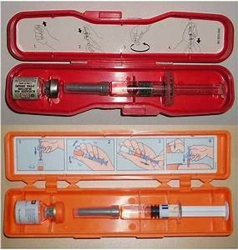
Glucagon/Glucagen
www.healthline.com
Notes:
2 different kits- made by different companies ; both 1mg/ml
Demonstrate use of glucagon
If Glucagon/Glucagen is given at school, follow the Glucagon administration page in the DMMP

Slide 44
Glucagon
There is a free glucagon app for smart phones (IOS and Android).
This is information and learning only.
It is not designed to be used in the case glucagon is needed.
Type in glucagon in your App Store.

Slide 45
Scenario 7
Cathy is a 10 year old student with Type 1 who was recently diagnosed.
She comes to your office for a blood sugar check before lunch. She also just came from PE.
Her blood sugar check is 62 and you notice she is slurring her words.
What do you do?
Since she is slurring her words, she will stay in your office for observation instead of going on to lunch.
She stays in your office and takes up to a 15 gram fasting acting carbohydrate. You will recheck her blood sugar in 15 minutes.

Slide 46
Scenario 7 continued
During the 15 minute interval, several other students come to your health room with varying needs. You hear sounds of students arguing.
Cathy is now arguing with another student.
You attempt to intervene and Cathy starts hitting and has become combative. This is not typical behavior for her.
What do you do?
You will give her the glucagon per her orders and follow the steps in the glucagon administration page in the diabetes medical management plan.
Students do not have to be passed out or having a seizure to receive glucagon.
They may be combative/completely uncooperative.
Notes:
Remember, even though the student has received a fast acting carb treatment for the low, the blood sugar can continue to drop.

Slide 47
Scenario 8
Susie is 16 years old and comes to you before lunch. Her blood sugar is 92.
She said she was going to eat 68 grams of carbohydrates for lunch and you gave insulin based on her orders and she went to lunch.
1 hour later you are called to the classroom because Susie is having a seizure.
What do you do?
Take the glucagon and glucose meter to the classroom and give her the glucagon dose.
Turn her on her side to protect her airway.
Check her blood sugar.
The meter reads LO
Notes:
This means the blood sugar is either less than 10 or less than 20 depending on the meter.
There is a page in the DMMP that will let you know based on the students meter.

Slide 48
Scenario 8 continued
While you were caring for Susie, another staff member was notifying parents and calling 911.
Her friend tells you Susie actually did not eat her lunch even though she had taken her lunch insulin dose.
The seizure stops before the paramedics arrive. If she is able, she is start drinking liquids with carbohydrates.
The parents also arrive and decide to have her transported to the local hospital for evaluation.
We advise parents for the first 24 hours after glucagon :
No school or physical activity
Closely monitored by an adult
More frequent BG checks including overnight
They are also to contact our office for review of episode to determine if insulin doses need to be adjusted
Notes:
In this case, discuss with Susie the importance of letting you know if she does not eat her lunch when she returns to school.

Slide 49

Monitoring Ketones
www.ketoxtix.com

Slide 50
Monitoring Ketones
Ketones are a poison that is made when the body burns fat for energy
  This usually occurs when there is not enough insulin in the body
Test for and manage ketones per the Diabetes Medical Management Plan
Ketostix are good for 6 months once the bottle has been opened as long as the bottle is still within expiration date on the bottle and the bottle has been tightly closed after each strip is removed
  If strips are exposed to air, dust particles, moisture, etc. it can affect the strips and give a false reading
Once urine is on the strip- wait 15 seconds before reading result
  Result as : negative, trace, small, moderate or large
  Do not use the numbers below the color

Slide 51
Scenario 9
Jamie, 12, comes for blood sugar check before lunch.
The blood sugar is 534. You send her to check for ketones.
The strip reads moderate-large. She does not complain of nausea or vomiting.
She does complain of thirst and being tired.
What is your first step? Does she have to go home?
Give her water to drink.
Calculate insulin dose (for meal and blood sugar) and send her to lunch.
She does hot have to go home. Follow the hyperglycemia algorithm for rechecking ketones and blood glucose level.
Notes:
The student may feel bad with ketones- remember they are a poison. However, they do not have to go home unless they have nausea/vomiting with the ketones. We encourage them to stay in school unless they have nausea/vomiting or are feeling poorly.

Slide 52
Scenario 10
It is the third week of school.
Julie has only brought her insulin and glucagon supplies to school.
Family has yet to bring ketostix or other remaining supplies.
You have left several messages.
What do you do now?
Follow your chain of command.

Slide 53
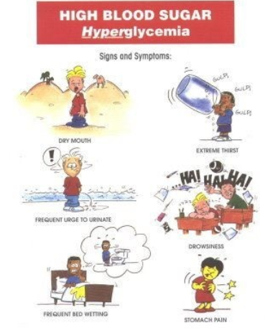
Hyperglycemia
https://bestmadenaturalproducts.com/

Slide 54
Scenario 11
Steve, 8 year old with Type 1, comes to you before PE to check his blood sugar per his Diabetes Treatment and Intervention Plan. PE is before lunch and he did not have a morning snack.
His blood sugar is 422. What is your first step?
Check for ketones.
His ketones are negative. It has been over 3 hours since he has had a correction factor or a meal dose. He will go to lunch immediately after PE.
Can Steve go to PE and participate? Does he have to get a correction factor dose?
Yes he can go to PE and participate. He does not have to get a correction factor dose since ketones are negative unless caregiver request it in his IHP.
Encourage him to drink water before going to PE
Notes:
Remember activity can help lower blood glucose readings.
Insulin orders say correction factor CAN be used every 3 hours – but it does not have to.
In this scenario we can wait and see if activity will lower his blood sugar. You will check him again before lunch and he can get a correction factor dose at that time if needed. Parents may address this also in the IHP.
Also unless parents request it or student has s/s of highs or lows you do not have to check a blood sugar before PE.

Slide 55
Contact Information
If Questions or Concerns:
Call Children’s of Alabama Diabetes Team
205-638-9100 (On-Call MD)
205-638-9107 (Diabetes office) Monday- Friday 8:30 am-4pm

Slide 56

Questions
Notes:
If you have any questions about the topics we just discussed, I will be happy to answer them now. Remember all SP and DMMP questions will be answered during the SP session later this afternoon.

