Slide 1
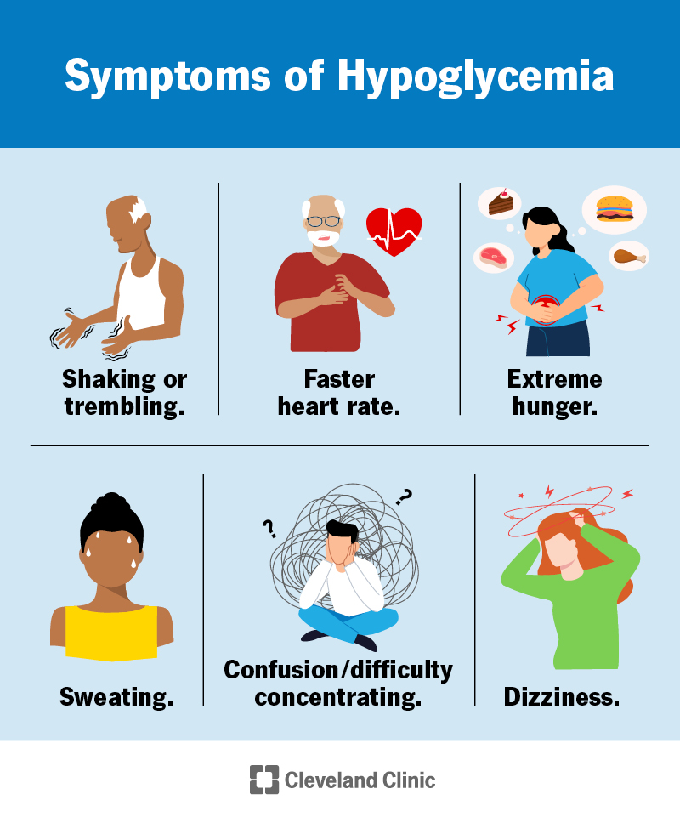

Taking Care of Yourself
What You Need to Know About Low Blood Glucose (hypoglycemia)
  Low blood glucose is when your blood sugar level falls below 70 mg/dL
  Use the 15/15 rule of 15g fast-acting carbs/15 minutes rule to treat low blood glucose
  It's important to treat low blood glucose levels as soon as possible, as they can quickly become dangerous
  Severe low blood glucose is an emergency and will require help from others to treat it

Slide 2
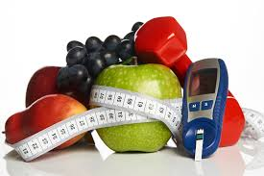
Taking Care of Yourself
Rule of 15
Give 15 grams fast acting carbohydrates
Examples: 4 oz juice or regular soda, 3-4 glucose tablets
Wait 15 minutes, recheck blood sugar
If less than 70—repeat until blood sugar above 70

Slide 3
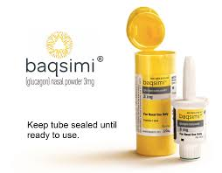
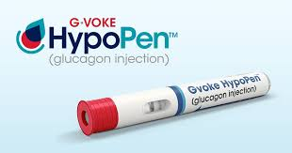
Severe Hypoglycemia
Causes:
Insulin overdose or miscalculation
A condition where blood sugar levels drop dangerously low.
Can be a life-threatening emergency requiring immediate medical attention.
Signs & Symptoms: could include severe confusion, seizures, or loss of consciousness
Causes:
  Insulin overdose or miscalculation
  Skipping meals / not eating enough carbohydrates
  Excessive exercise without adequate carbohydrate intake
  Certain medications (sulfonylureas and insulin secretagogues)
  Alcohol consumption
Emergency Medications:
  If your adult provider does not prescribe it – ASK FOR IT

Slide 4
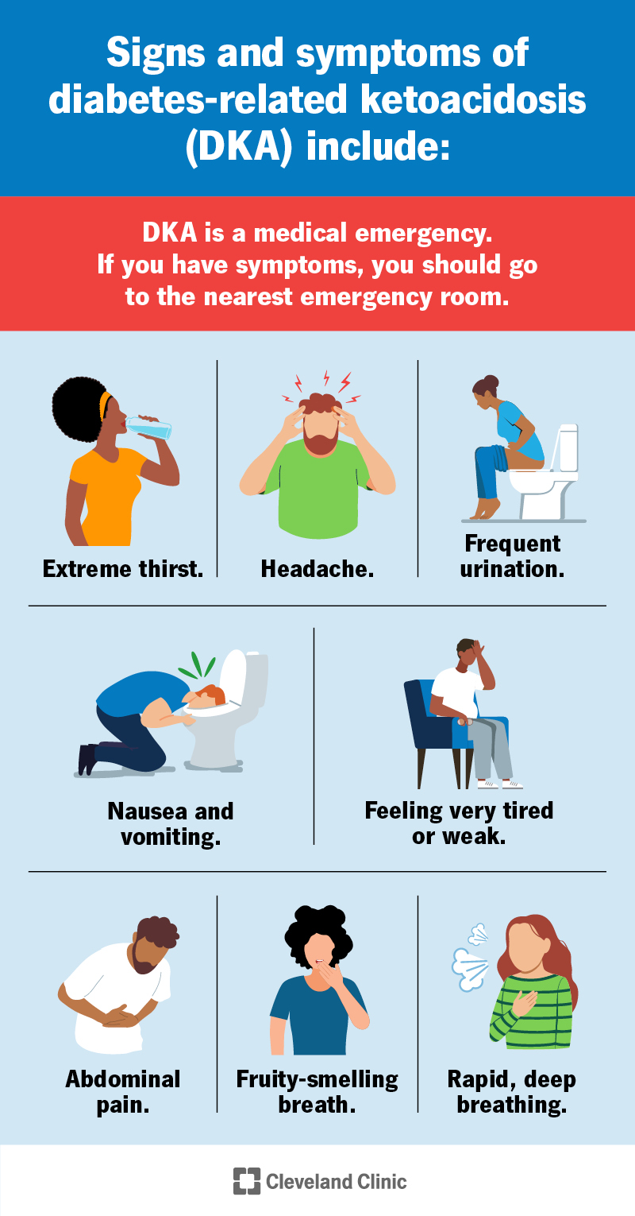
Ketones
When there's not enough insulin to help glucose enter cells, the body switches to burning fat, creating ketones as a byproduct.
Ketones are an early warning sign and if not managed correctly they can lead to a serious condition called diabetic ketoacidosis (DKA).

Slide 5
Ketones
Monitoring:
  Anytime blood sugar levels are 240 or higher and keep checking until levels are negative
  When you are sick
Treatment for ketones:
  Give correction factor if it has been at least 3 hours (2 hours if you have a pump) since last correction.
  Drink at least 8 ounces of water every hour
  Take long-acting insulin at usual time if not on a pump
  Take insulin for food eaten unless eating less than 15 grams of carbohydrates an hour
  If having nausea, vomiting and moderate to large ketones go to the nearest ER and call the on-call number for your Adult Endocrinologist.

Slide 6
Diabetic Ketoacidosis
Symptoms of DKA:
  Symptoms include excessive thirst, frequent urination, fruity-smelling breath, nausea, vomiting, fatigue, and confusion.

Slide 7
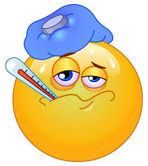
What Do I Do If I Am Sick?
If taking insulin by injection—do not skip long-acting Insulin doses even if you are vomiting or do not want to eat
It is important to eat some carbohydrates even if in a liquid form.
Check urine for ketones with every void even if negative (at least every 4 hours).
Do not exercise if sick with moderate to large ketones.
Contact provider before taking anti-vomiting medications.
You may need to contact your adult provider for insulin dose adjustments during sick days.

Slide 8
Sick Day Guidelines (Able to Eat)
Eat normal meals and snacks.
Examples of carbohydrate snacks: saltines, toast, applesauce, baked potato, graham crackers, and bananas
Give insulin for meals and snacks using carbohydrate ratio or set dose.
Give insulin for high blood glucose levels every 3 hours as needed using correction factor or sliding scale.
Stay hydrated and drink up to one cup of sugar free, caffeine free fluid every hour while awake.
Examples of fluids: broth, water, Diet Sprite, flavored drinks with Crystal Light, Gatorade zero, PowerAde zero, and Vitamin Water zero

Slide 9
Sick Day Guidelines (Unable to Eat)
Check blood glucose levels every 3 hours.
Give insulin for high blood glucose levels every 3 hours as needed using correction factor or sliding scale.
Stay hydrated and drink at least 15 grams of carbohydrates in a liquid form every hour if able to tolerate.
Examples of carbohydrate fluids: ½ cup of juice, ½ cup of sherbet, ½ cup of regular Jell-O, ½ cup of regular soda, 1 cup of Gatorade, and 1 ½ cups of chicken noodle soup

