Slide 1
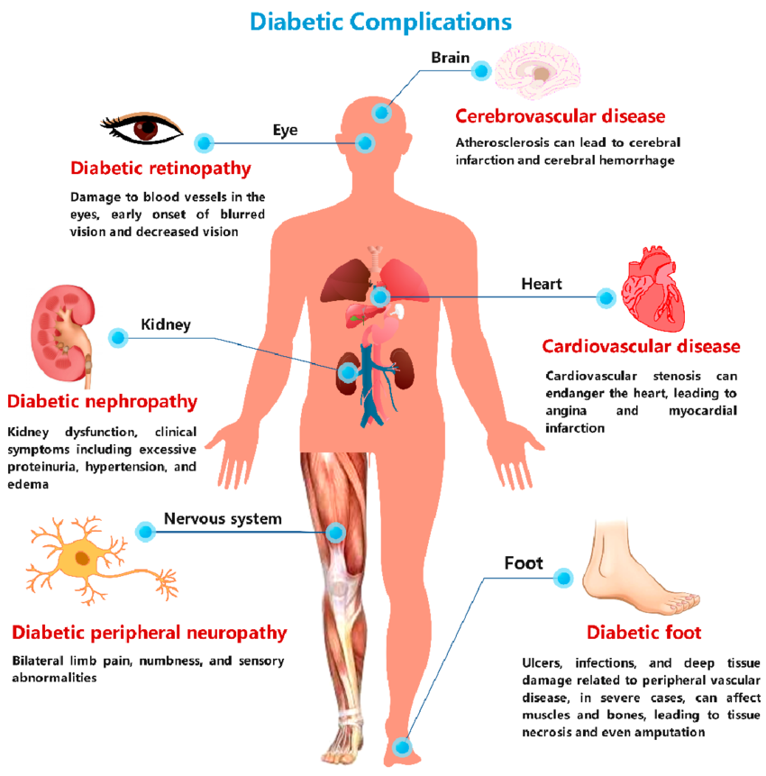

Long Term Complications

Slide 2
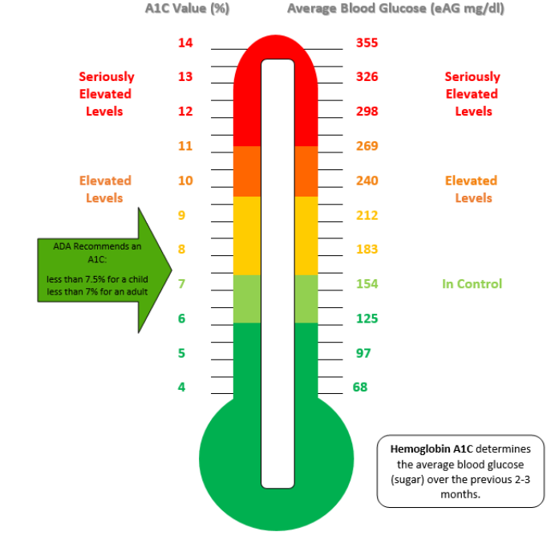
What Can I Do To Prevent Complications?
  Keep blood glucose within recommended range
      Daytime: 70-130
      During the night: 90-150
  Keep Hemoglobin A1c within recommended range
      Less than 7%
  Avoid smoking tobacco and being around secondhand smoke
  Maintain a healthy blood pressure, cholesterol level, and weight
  Include physical activity into your daily routine (discuss with provider recommended intensity)
  Visit provider as recommended

