Slide 2


Diabetes and the Workplace
Let your boss / supervisor know you have diabetes
Topics to mention:
  Work breaks
    Bathroom, lunch, etc.
  Food / drink policies
  Phone usage
Remember: Taking care of yourself is just as important as the work you are assigned to in any job

Slide 3
Qualified Person with a Disability
Establishing that the worker has a disability, "a record of" a disability, or is "regarded as having" a disability
Disability
  mental or physical impairment that substantially limits one or more major life activities
Diabetes is a disability because it substantially limits major life activities such as the functioning of the endocrine system, among others
Qualifications
  One who satisfies the skill, experience, education, and other job-related requirements of the
  Can perform the essential functions of that position when given reasonable accmodations

Slide 4
Workplace Rights
Your employer:
Cannot fail to hire or promote you because of your diabetes
Cannot terminate you because of your diabetes
-unless you pose a “direct threat”
Must provide you with reasonable accommodations that help you perform the essential functions of your job
Cannot discriminate about employer-provided health insurance.
You are protected from discrimination because of your diabetes
Direct Threat: the person with a disability poses a significant risk of substantial harm to the health / safety of the person / other employees that cannot be eliminated by reasonable accommodation

Slide 5
What Laws Protect Me From Discrimination at Work?
Americans with Disabilities Act
Private employers
Labor unions
Employment agencies with 15 or more employees
State and local government.
Rehabilitation Act of 1973
Employees who work for the executive branch of the federal government, or for
Any employer that receives federal money.
Congressional Accountability Act
Employees of Congress and most legislative branch agencies
*All states have their own anti-discrimination laws and agencies responsible for enforcing those laws. Some state anti-discrimination laws provide more comprehensive protection than do the federal laws.

Slide 6
Reasonable Accommodations
Any change or adjustment to a job or work environment that enables a person with a disability to do the job
Required if requested by an employee with a disability
Unless the accommodation would cause an "undue hardship" on the employer because of significant difficulty or expense.
Usually easy and inexpensive for someone with Diabetes

Slide 7
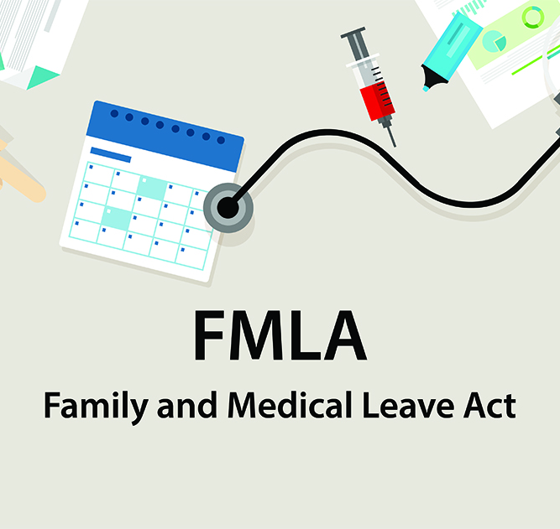
  Require of most private employers and most government employers
    Employers with over 50 employees
    Provides up to 12 weeks of leave per year
    For worker’s (or an immediate family member’s) serious health condition.
  Can be taken in small blocks of time or all at once
    Examples: Time for managing blood glucose levels or for doctor's appointments

Slide 8
What are My Rights if I am Terminated From My Job Because of my Diabetes?
Contact the American Diabetes Association
https://diabetes.org
They can help you understand your rights and the legal processes available to you.
You have a right to file a charge of discrimination with the Equal Employment Opportunity Commission (EEOC) or your state fair employment agency.
Other options available, depending on the situation:
Filing a union grievance
Negotiating a return to work with your employer

Slide 9
Alabama Department of Rehabilitation Services
Provides individualized employment, education-related services, and training to assist youth and adults with disabilities achieve their employment goal.
Designed specifically to meet the needs of each individual
Services available through VRS field offices statewide may include:
Employment Services
Counseling and Guidance
Assistive Technology
Transition Services
Educational Services
Job Training
Vocational Assessment
Other Rehabilitation Services

