Slide 1
Building Readiness, Independence, Diabetes Guidance & Empowerment

Slide 2

Let’s Talk Insurance
Medicaid ends the month of your 19th Birthday
It you are on your parents’ insurance, most plans can keep you covered up to age 26
When seeking employment, insurance coverage, especially health insurance, is often a key factor in choosing a job.

Slide 3

Importance of insurance coverage when seeking employment:
1. Financial Security and Peace of Mind:
Protection from Unexpected Costs:
Health insurance helps protect employees from the financial burden of unexpected medical expenses, allowing them to access necessary care without the fear of crippling debt.
Access to Quality Healthcare:
Insurance coverage ensures access to quality medical care, leading to better health outcomes and a higher quality of life.
Reduced Financial Strain:
Knowing that medical expenses are covered can alleviate financial stress and allow individuals to focus on other aspects of their lives.

Slide 4

2. A Key Factor in Job Decisions:
Employee Preference:
Many employees prioritize health insurance when deciding to accept a job, with surveys showing that a large percentage consider it a "very important" factor.
Job Satisfaction:
Having access to comprehensive health benefits can contribute to higher job satisfaction and employee retention.
Competitive Advantage:
Employers who offer strong insurance packages are often seen as more desirable employers, attracting and retaining top talent.

Slide 5
3. Beyond Health Insurance:
Other Types of Insurance:
Beyond health insurance, other types of insurance, like life insurance and disability insurance, can provide valuable financial security and peace of mind, especially for families.
Understanding Coverage:
It's crucial to understand the types of insurance offered by employers and how they work to ensure you have adequate coverage and can make informed decisions.
Employer-Sponsored Insurance:
Employer-sponsored insurance is often a more affordable and efficient way to obtain coverage, with employers often sharing the cost of premiums and offering tax advantages.

Slide 6

What is a deductible?
The amount of money you pay out of pocket for certain covered health care services before your health plan starts to pay.
Example:
  You have a health insurance policy with a $1,000 deductible and you receive a medical bill for $2,000.
  You would be responsible for paying the first $1,000 and your insurance would cover the remaining $1,000.

Slide 7
What is a copay?
A fixed amount you pay for a covered health care service, usually at the time of service.
A standard part of many health insurance plans
How copays work:
You pay your copay after you've paid your deductible.
The amount of your copay can vary depending on the type of service and the provider.
For example, a copay for a doctor's office visit might be lower than a copay for a prescription or lab test.
Copays are usually paid at the time of service, such as at the doctor's office.

Slide 8
When do copays apply?
Copays apply to many services, including doctor visits, prescriptions, physical therapy, occupational therapy, speech therapy, and emergency room visits.
Some services may be covered at no additional cost, such as annual wellness exams.

Slide 9
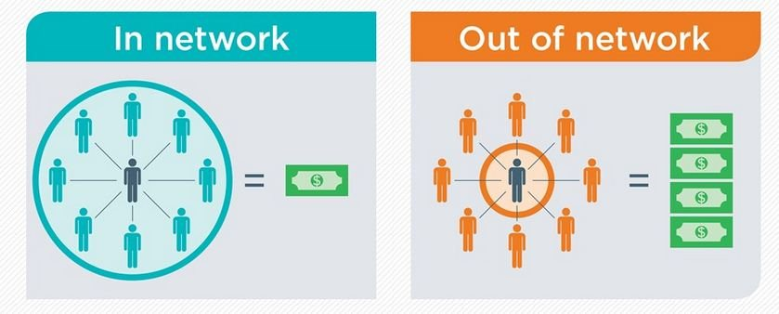
In-network vs. out-of-network
The distinction between in-network and out-of-network services can affect copayments. In-network providers have lower copayments.

Slide 10
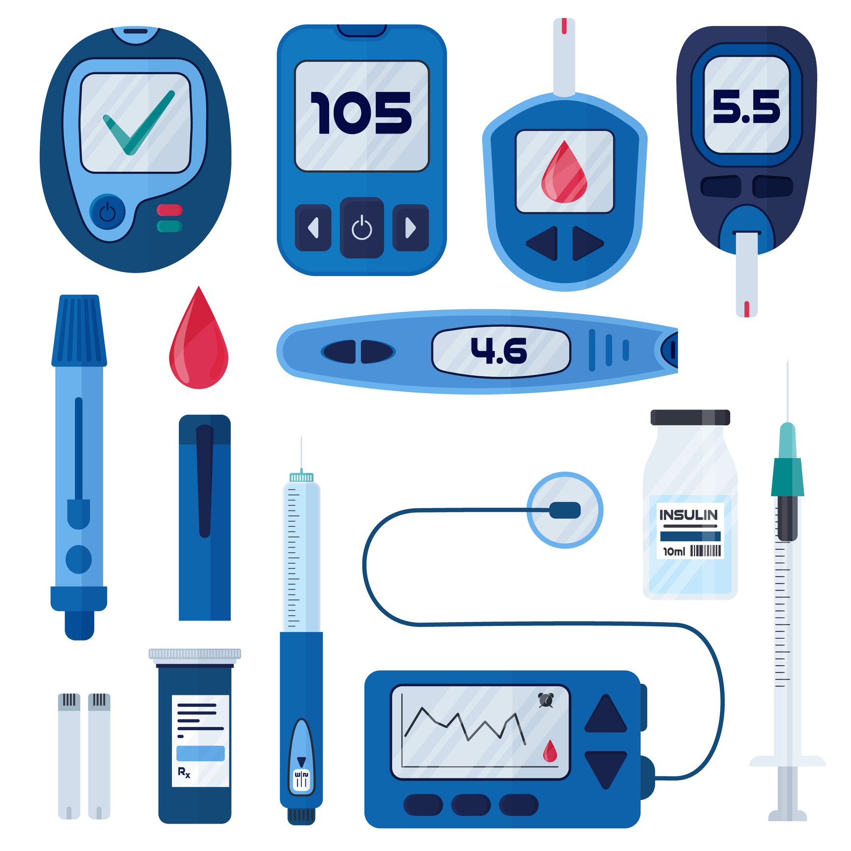
What is a DME Provider?
A DME provider is a company or organization that supplies durable medical equipment (DME) to patients, like wheelchairs, oxygen concentrators, walkers, and diabetes supplies

Slide 11
What are Pharmacy Benefits?
A pharmacy benefit covers prescription medications that patients can self-administer at home. Typically with a co-pay.
The key difference is that DME providers often focus on more complex medical devices requiring extensive patient education and support, whereas pharmacies primarily dispense medications with less in-depth device training involved

Slide 12
What happens if I find myself without Insurance?

Slide 13
Lilly Cares Patient Assistance Program
Lilly Cares Patient Assistance Program
Helping patients with financial need receive their prescribed Eli Lilly and Company (Lilly) medications at no cost or low cost
You may be eligible for the Lilly Cares Program if:
You are a permanent resident of the United States (inclusive of Puerto Rico and the U.S. Virgin Islands).
Your healthcare provider has prescribed a medication offered through Lilly Cares.
The following applies to you with regard to your insurance coverage: You are not enrolled in Medicaid, full Low Income Subsidy (LIS, “Extra Help”) or Veterans (VA) Benefits
For all Medications, you do not have an insurance plan or third party that requires you to apply to the Lilly Cares Program as a condition, requirement, or prerequisite for coverage of specific Eli Lilly and Company medications. Additional information on such ineligible programs, often referred to as alternative funding programs, for-profit patient advocacy programs, or specialty cost-containment networks (collectively known as "AFPs"), is provided below*.
You meet the insurance requirements for the medication for which you are applying. Insurance requirements are listed below for each Medication Group.
You meet the household income guidelines for the Program.

Slide 14

Lilly Cares Patient Assistance Program
What medications are available?
Basaglar® (insulin glargine injection)
Humalog® U-200 (insulin lispro injection)
Humalog® Mix50/50™ (insulin lispro protamine and insulin lispro injectable suspension)
Humalog® Mix75/25™ (insulin lispro protamine and insulin lispro injectable suspension)
Humulin® 70/30 (human insulin isophane suspension and human insulin injection)
Humulin® N (isophane insulin human suspension)
Humulin® R (insulin human injection)
Lyumjev® (insulin lispro-aabc) injection

Slide 15
Lilly Cares Patient Assistance Program
How do you apply?
  You can complete an online application. Choosing to use the online application reduces paperwork and potential for delays.
You can Print an application off of the website
https://www.lillycares.com/how-to-apply
Lilly Insulin is $35 or Less a Month: Get your $35 savings card here.
An automatic $35 max out-of-pocket monthly cost for people with commercial insurance at the majority of retail pharmacies
An easy-to-download savings card that provides a $35 max out-of-pocket monthly cost for people who are uninsured, or need to use a non-participating retail pharmacy
https://www.lilly.com/resources/insulin-affordability

Slide 16
Novo Nordisk Patient Assistance Program (PAP)
The Patient Assistance Program provides medication at no cost to those who qualify.
Can not be mailed to home address. Must be mailed to MD’s office.
  Many Providers do not accept.
Who can participate in the Patient Assistance Program?
  Be a US citizen or legal resident
  Have a total household income that is at or below 400% of the federal poverty level (FPL). Visit the NeedyMeds website, which lists the current FPL guidelines
  Have Medicare or no insurance (Note: If you have private or commercial insurance, you are not eligible for the PAP)
  Not be enrolled in or qualify for any other federal, state, or government program such as Medicaid, Low Income Subsidy, or Veterans Affairs (VA) Benefits
If you are eligible for Medicaid, you must sign the Patient Declaration section of the latest version of the PAP application stating that you are not enrolled in, plan to enroll in, or are eligible for Medicaid or Medicare Extra Help/LIS (proof of denial must be submitted if requested)

Slide 17
Novo Nordisk Patient Assistance Program (PAP)
What medications are available?
RYBELSUS® (semaglutide) tablets
Xultophy® 100/3.6 (insulin degludec & liraglutide injection) 100 U/mL & 3.6 mg/mL
Fiasp® (insulin aspart) injection 100 U/mL
Novolin® (human insulin [rDNA origin] injection) 100 U/mL
NovoLog® (insulin aspart) injection 100 U/mL
NovoLog® Mix 70/30 (insulin aspart protamine and insulin aspart injectable suspension) 100 U/mL
Tresiba® (insulin degludec) injection 100 U/mL, 200 U/mL
NovoPen® Echo
Disposable Needles (only available for FlexPen®, FlexTouch®, and Xultophy® 100/3.6)
Zegalogue® (dasiglucagon) injection 0.6 mg/0.6 mL

Slide 18
Novo Nordisk Patient Assistance Program (PAP)
How do you apply?
Applying online is a step-by-step process that tells you what to do next. However, you can also apply by paper. Just see the “How to apply" section on this page.
https://www.novocare.com/diabetes/help-with-costs/pap.html

