Slide 1
Surgical Attire
Martin Kircus, MSHA, BSN, RN, CNOR
Operating Room Director
Lunch & Learn 2025

Slide 2
What “YOU” Wear is Very Important!
Surgical Scrubs
Surgical Outerwear
Nail-Adornment
Footwear
Head Covering: Caps, Bonnets, Bouffants
Jewelry

Slide 3
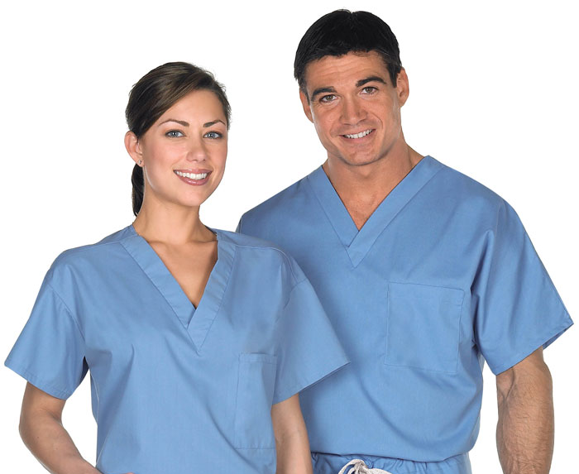
At Children’s of Alabama, you can wear your own scrubs or our scrubs! Whatever color or pattern that you like!
The staff loves it! Everyone can show their own personality
Caution:
There are some guidelines!

Slide 4
Laundering Instructions!
Scrub attire may be home laundered by staff with the below instructions:
An automatic washer and hot-air dryer is required.
Wash scrub tops, bottoms, hats and outerwear separately from other laundry.
Use the hottest water temperature setting recommended by the manufacturer to facilitate microbial kill.
Detergent will be used following manufacturer's recommendations.
Scrub attire (scrub tops, bottoms, hats, outerwear) will be submerged completely in the water during the entire wash and rinse cycles.
Household bleach will be used unless the manufacturer specifically recommends against the use on the scrub attire label. If bleach is contraindicated, oxidizing bleach such as those containing hydrogen peroxide will be used.
After the wash cycle, clean and disinfect the washer door, handle, buttons and other surfaces.
Scrub attire will be dried in the hot-air dryer and not hung to dry.
Avoid short or rapid wash cycles

Slide 5
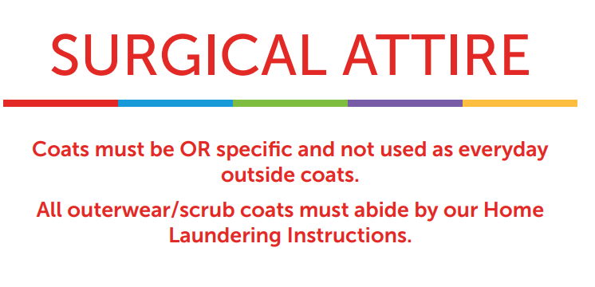

Slide 6
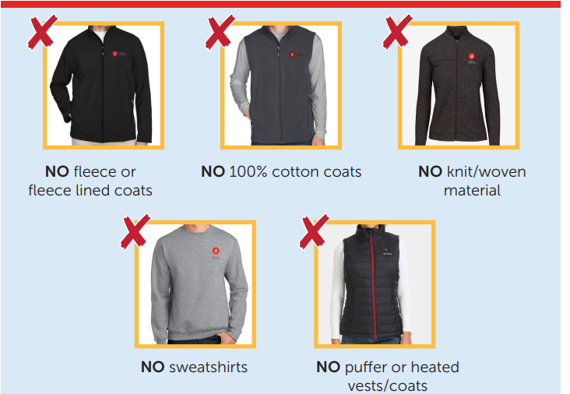

Slide 7
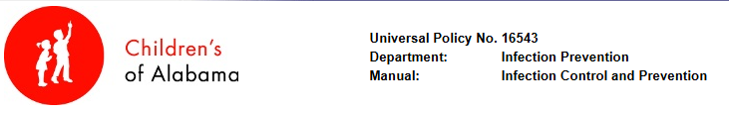
  Nails & Nail Adornment: Nails must be kept clean, short, and trimmed. Artificial nails/nail tips, nail polish and other nail decorations are not allowed by SCRUBBED personnel: this includes all providers, Dental Assistants, Scrub Techs, RN Scrubs.
  Footwear: We ask that you dedicate a pair of clean, comfortable shoes to the O.R. Wear shoe covers if you expect excessive blood or body fluids. Keep them clean after visits.
  Hair/Head: Hair should be clean and covered behind the red line. All facial hair should be covered, reusable hats are treated like your scrubs: one use and then laundered according to policy. Wear eye protection while scrubbed in at all times.
  Jewelry: If you are in a scrub role, dental assisting-no jewelry on hands and arms. No watches, bracelets, rings. Only stud earrings should be worn and covered by your head cover.

Slide 8
Protect your patient, your self & your family!
If you ever become soiled with a substantial amount of body fluid, we have a process for taking care of your scrubs. Please reach out to us-we will give you a pair of our scrubs to change into and take your scrubs to have them laundered.
These processes are to provide a safe environment for our patients and surgical services team members.
We want our staff to bring as little contamination into our O.R.s as possible and take as little contamination home as possible.
Please don’t be offended if we ask questions about your attire-we may need to know if its suitable for our environment. We may have to inspect the materials used in making them.
All persons entering the semi-restricted, restricted or procedural areas are required to wear approved surgical attire that is lint free. No fleece, flannel or 100% cotton should not be worn in these areas.
If you have any questions please reach out to your Team Leaders, Debbie Randau, Martin Kircus or Chrissy Evans!
Thank you for your cooperation and your time today!

Slide 9

Remember:
We all work under the same policies, procedures, Joint Commission Standards, Regulations & Expectations: Neurosurgery, Orthopedics, General, Eyes, Plastic, OMFS, Dental, Transplant, Urology, GI, IR and GI! We are in this together.

