Slide 1

ONe day Surgery
Jason Brooks, RN

Slide 2
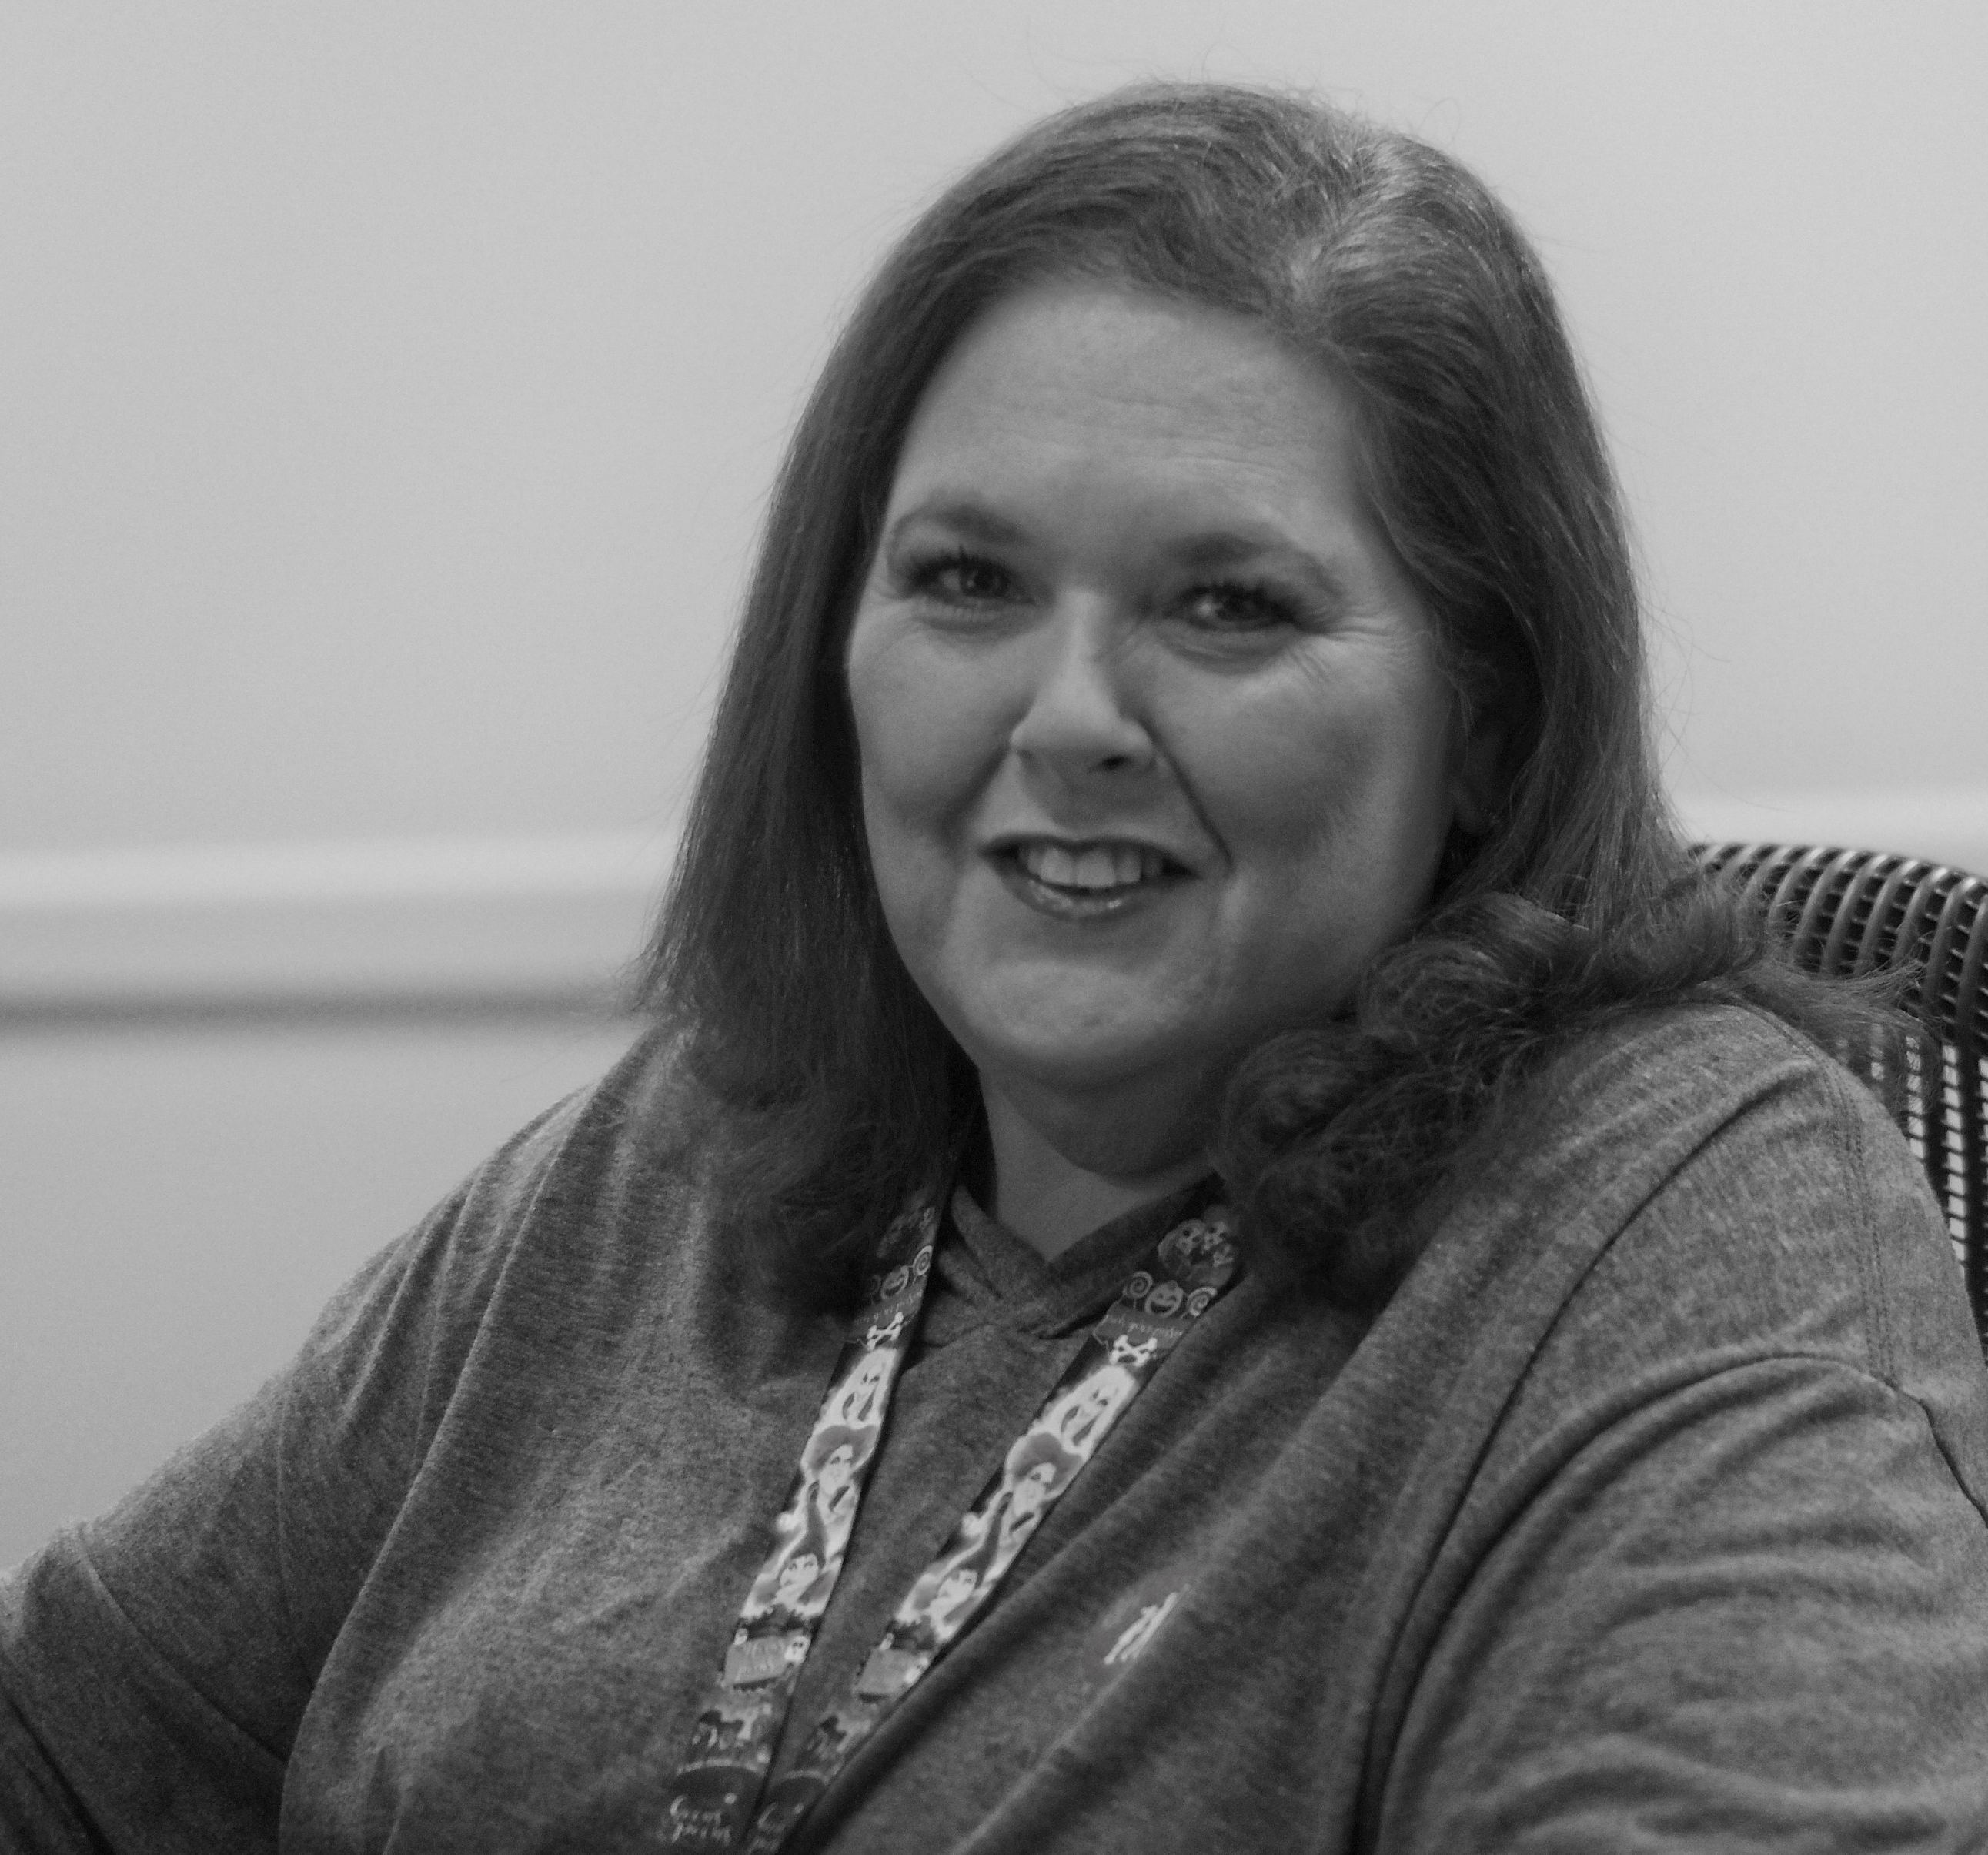
About us
See all non-CV surgical outpatients and any surgical patients that are being admitted after surgery.
One Day Surgery had contact with 17,453 pre-op patients, and 15,362 post-op encounters.
32,815 patient encounters in the last 12 months.
Since 2022 a 20% increase in volume.

Slide 3


Slide 4
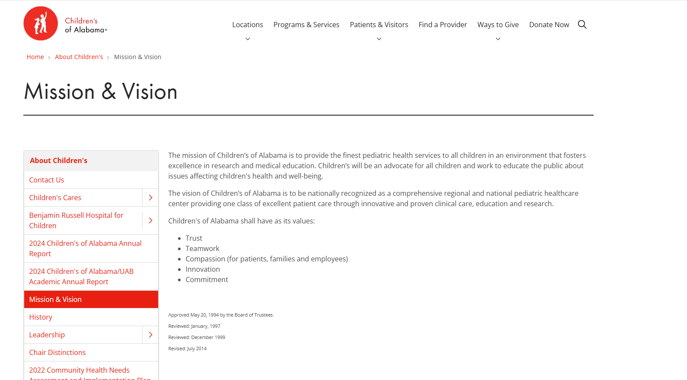

Slide 5

Coach=Provider

Slide 6

Patient = Football

Slide 7

Quarterback = Operating room

Slide 8
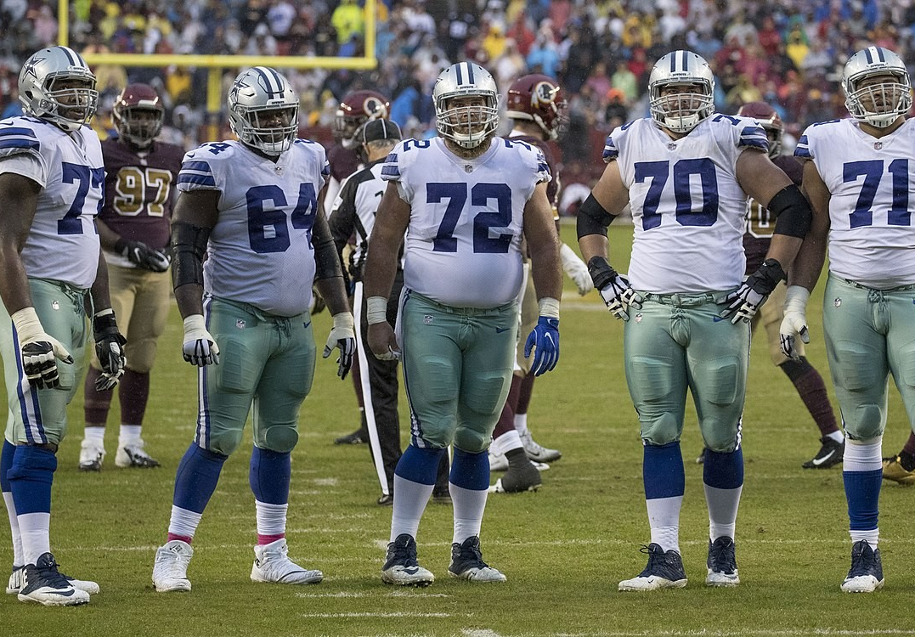
Offensive Line = One Day Surgery

Slide 9

Signal Callers = Clinics/Schedulers

Slide 10
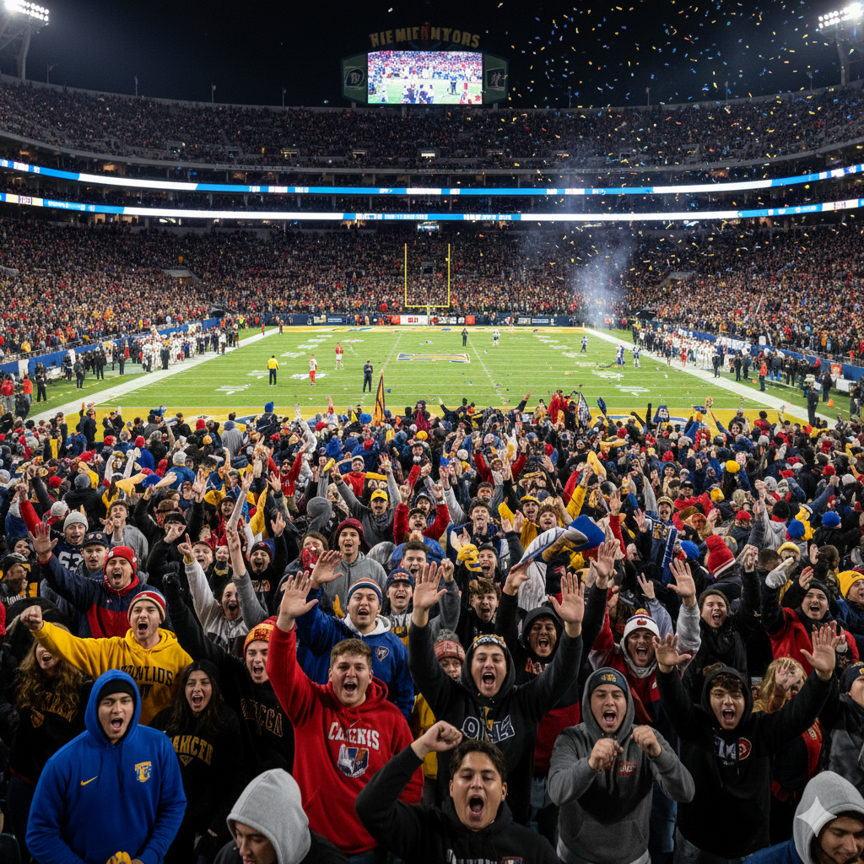
Fans = Families

Slide 11
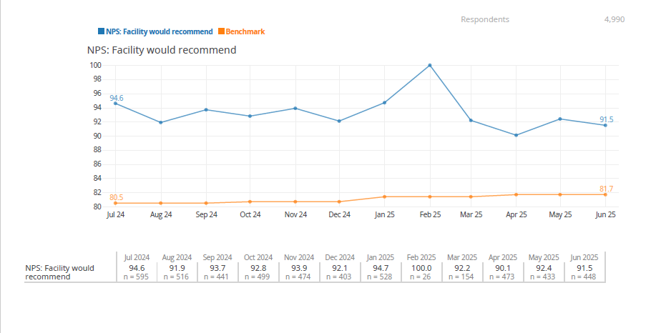

Slide 12
Wait time was the most negative theme
when looking at complaint theme rankings
Theme | Frequency (n=68) | Percentage | Key Examples
Wait Time/Delays | 32 | 47% | 4-5 hour waits for 15-minute procedures;
Communication Issues | 21 | 31% | No delay notifications

Slide 13
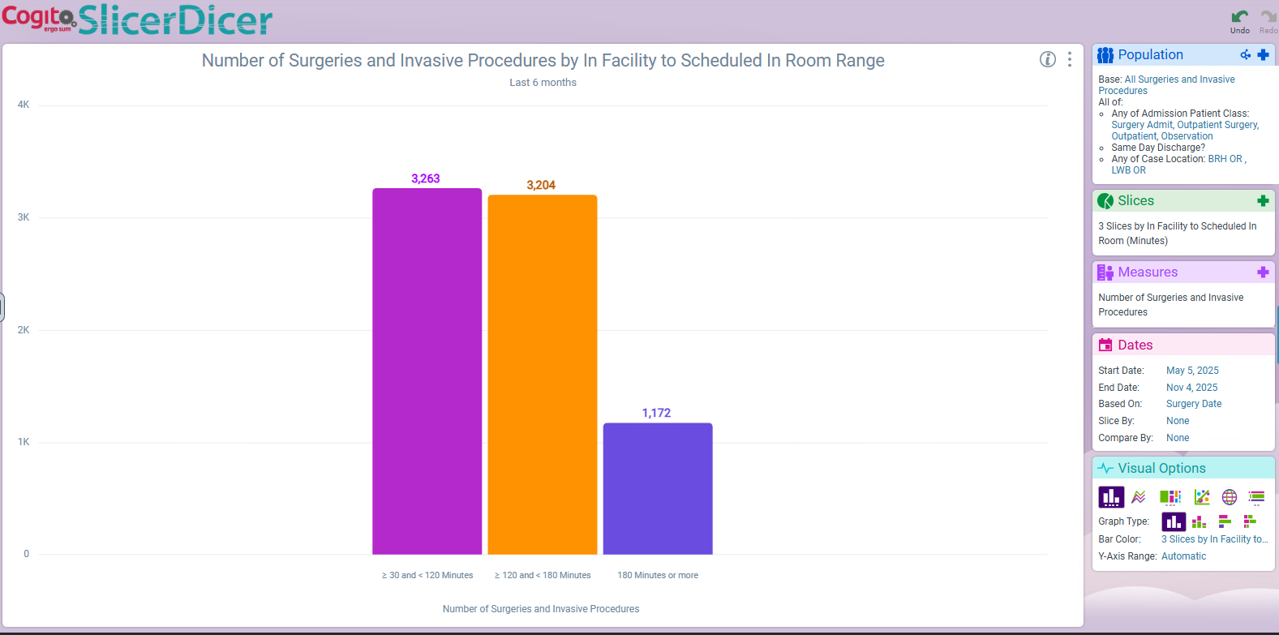

Slide 14
One Day Surgery Arrival
Each surgeons’ office is responsible for giving parent/patient an arrival time for day of surgery.
To ensure ample time for preparation, patients only need to arrive 1.5 to 2 hours before their expected surgery time.
Patients with additional medical conditions like Hemophilia, sickle cell disease and others may require customized preparation and planning.
Consult with ODS Charge Nurse in advance to assist with planning

