Slide 1
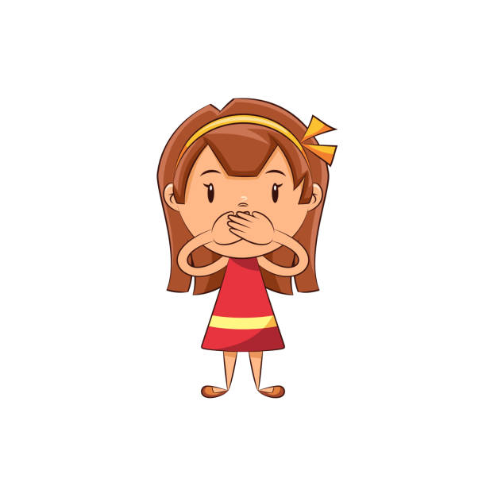


Slide 2
NPO Guidelines For Surgery Patients
Ingested Material | Recommended Minimal Fasting/Nothing By Mouth (NPO) Prior to Anesthesia | Comments
Clear Liquids | 1 Hour | Clear Liquid Examples: Water/Ice, fruit juices without pulp (apple juice, white grape juice, etc), carbonated beverages/sodas (Sprite, 7UP, Sierra Mist, etc), light colored Pedialyte – NO PROTEIN, clear tea, black coffee, light colored Gatorade/Powerade, light colored gelatin/Jell-O or light colored water-based popsicles NO red liquids
Breast Milk | 3 Hours
Infant Formula | 6 Hours
Non-Human Milk | 6 Hours

Slide 3
NPO Guidelines for Surgery Patients
Ingested Material | Recommended Minimal Fasting/Nothing By Mouth (NPO) Prior to Anesthesia | Comments
Solids | 8 Hours | Meals that include fried or fatty foods or meat may prolong gastric emptying time. Additional fasting time (e.g., 8 hours or more) may be needed in some cases. NO gum, candy, applesauce or pudding within 8 hours of the patient’s arrival/OR time.

Slide 4
Interpreters/Language Services
Family members – not medical interpreters
Affiliate Interpreters
Video Remote Interpretation (VRI)
Over-the-phone interpretation (OPI)

Slide 5

(205)638-9191
Patient Relations

