Slide 1

2025 Surgical Services Lunch N Learn
Surgery Scheduling
Carolyn Roberts
November 14, 2025

Slide 2
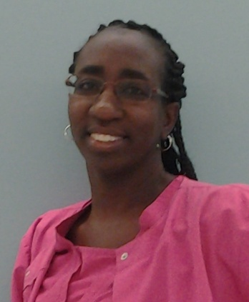

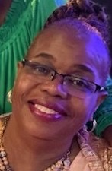

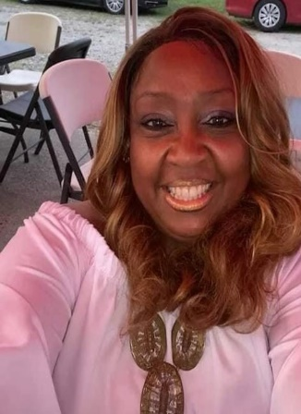
Surgery Scheduling Team
Carolyn Roberts Cherrell Ford Martha Larkins Nekingi Battle Glynda Marshall
Sr. Scheduler
Martin Kircus, OR Director, MSHA, BSN, RN, CNOR
Debbie Randau, OR Asst. Director, MSN, RN, CNOR
205-638-9777

Slide 3
Reminders for 2025?
Please make sure that you are scheduling all patients with their legal name and correct DOS when posting cases
A CPT code is required for multiple procedures in the EPIC system. *CPT codes are updated every January*
Only answer the question Yes (Admit prior to surgery) if the patient will be an inpatient the DOS
Make sure that you indicate the case classification in the EPIC system
If you are still submitting your cases in the WEB scheduling portal and you’re making a change to a case that is already scheduled. Please remember to indicate your changes (i.e. Rescheduling from 9/10 to 10/2) under Step 6 Confirmation in the Additional form details box.

Slide 4
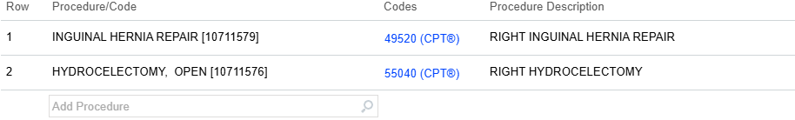

Slide 5
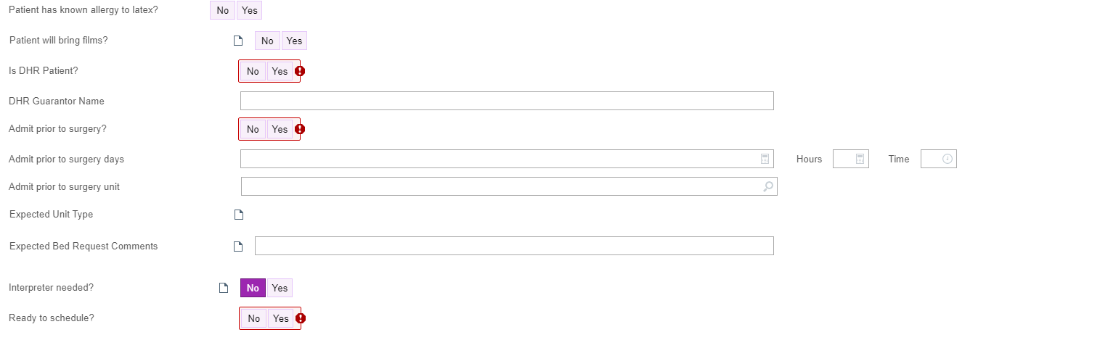
Questions Tab in EPIC
Make sure you answer all the questions with the RED ! Because they are required questions. Only if the patient is being admitted the day before surgery do you answer the question YES Admit prior to surgery. If the patient is coming through One Day that question is No.

Slide 6
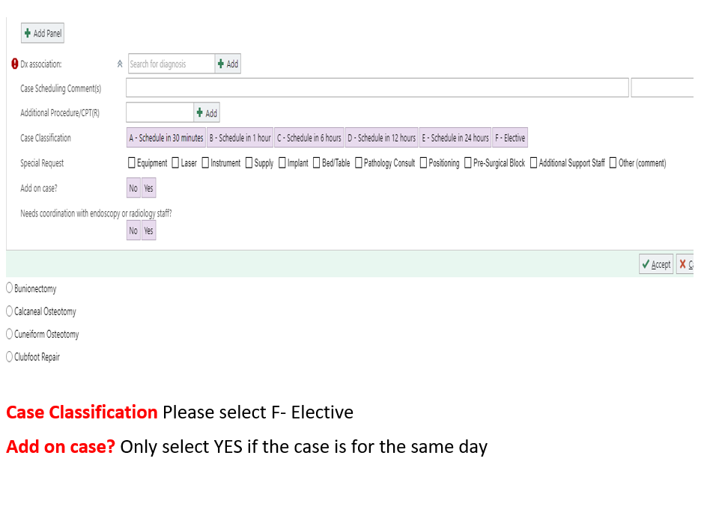
Required Fields for EPIC

Slide 7
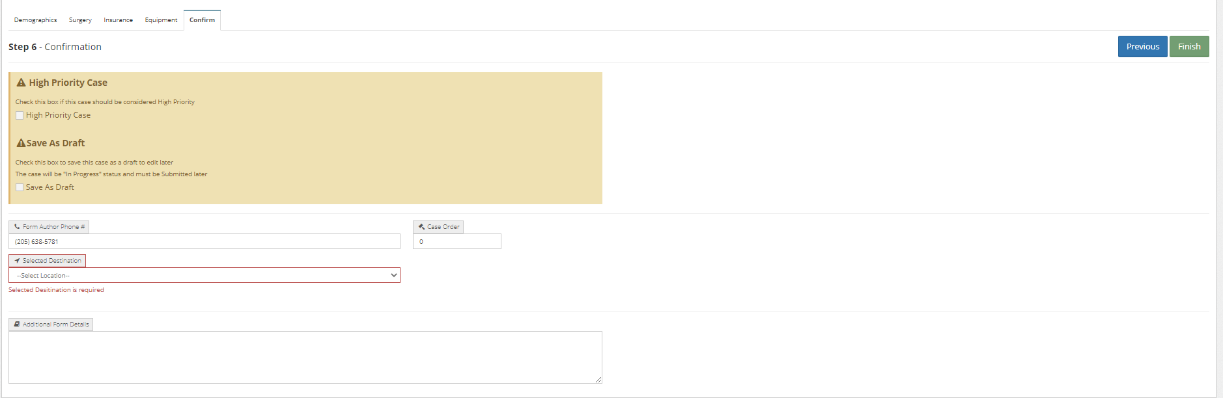
Required Fields for WEB Scheduling

Slide 8
Questions

