Slide 1

Dental process at coa
Christine Evans, RN
Continuous Quality Improvement Coordinator
Surgical Services

Slide 2
dental assistant Application Process
Current application is available on the Surgery Resources Page
www.childrensal.org/surgery-resources Username: resources Password: childrensal
Email all applications to: Lillie.Busby@childrensal.org
Application fee is $50.00
Make check out to Children’s of Alabama
Mail in with the correct pages of the application to Medical Staff Services
Applications will not be approved until the application and fee have been received and the Background Check has been completed
All Applicants will be required to apply for a Badge
Directions are on the Surgery Resources Page
Once the Applicant has been approved and all supporting documentation received, your office will be contacted by Lillie to arrange a date for the Orientation Class. Applicants must complete this course before working in the O.R.

Slide 3
New Dental Assistants are required to attend the Orientation Class prior to working in the O.R. Classes will be offered once a month.
Orientation Class for New Applicants
Course Includes:
Education on working in the Operating Room
Tour of the O.R.
Validation of competencies taught in class
Review of O.R. Pertinent Policies

Slide 4
Or policies at a glance
If scrubbed in- No nail polish, no rings, watches or bracelets
If scrubbed in, eye protection and mask is required
No outside coats, no fleece, no 100% cotton, no knit/woven, no sweatshirts, no puffer or heated coats

Slide 5
Renewal of privileges
All information will be due by May 31, 2026
If requirements are not met by due date, applicant will be required to reapply, including the $50.00 fee.
Submit all renewal items to Lillie.Busby@childrensal.org
Items Required:
* Valid BLS (CPR) card
* Record of Flu Vaccine given within 12 months
* Proof of Liability Insurance
with Assistants names listed
* Current Evaluation
from Dentist form on Resource page
* Annual TB Mask Fit Test To be done in the O.R.

Slide 6
1. COLLECT THEIR COA BADGE AND TURN IT IN TO AN O.R. MANAGER.
2. NOTIFY LILLIE BUSBY IMMEDIATELY VIA EMAIL
IF AN ASSISTANT LEAVES YOUR OFFICE

Slide 7
Mipacs imaging
Save images immediately after taking x- rays
This means before moving the computer on wheels. If for some reason they have not been saved, there is no way to retrieve them.
If you need assistance with the Dicom Server &/or obtaining your imagines contact the IT Help Desk COAHelp@childrensal.org

Slide 8
* PLEASE DO NOT BRING ANYTHING THAT WE CURRENTLY PROVIDE.
T BANDS, COTTON PELLETS, DENTAL ROLLS ETC.
* do not bring in anything peel packed
* SUPPLIES YOU BRING MUST BE IN ORGINIAL CONTAINER, AND NOT EXPIRED.
* Continued disregard for rules will result in REDUCTION OR LOSS OF BLOCK TIME
NEW PROCESSES
WE ARE WORKING TO PROVIDE EVERYTHING NEEDED FOR DENTAL PROCEDURES.
DENTAL SUPPLY UPDATE

Slide 9
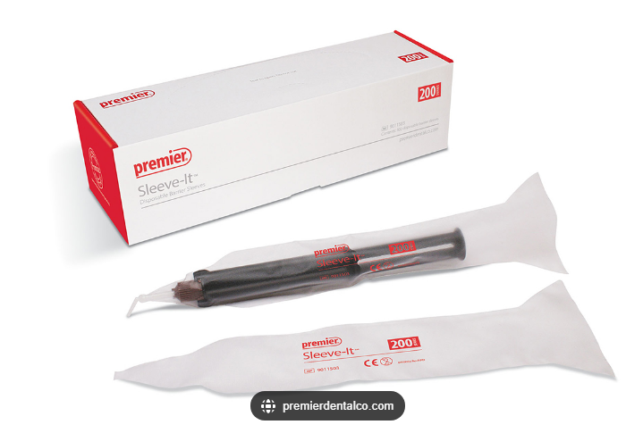
YOU MUST COVER ALL MULTI-USE SYRINGES.
IF THEY GET WET OR CONTAMINATED, YOU MUST DISPOSE OF THEM. YOU CAN not WIPE THEM OFF PER JOINT COMMISSION
NEW PROCESSES
DENTAL SUPPLY UPDATE

Slide 10
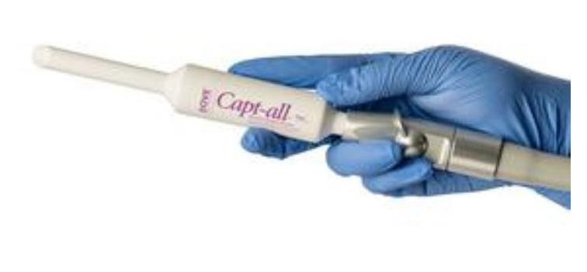
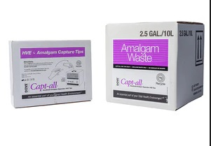
IF YOU USE AMALGAM, YOU MUST REQUEST AN HANDHELD AMALGAM CAPTURE KIT.
YOU MUST USE THIS PER THE FDA
DISPOSE OF THE TIP IN THE AMALGAM WASTE CONTAINER
LOWDER: DECONTAMINATION ROOM
OR
BR: DECONTAMINATION ROOM
NEW PROCESSES
DENTAL SUPPLY UPDATE

Slide 11

IF YOU HAVE LEFT OVER AMALGAM, OR EXTRACT A TOOTH WITH AN AMALGAM FILLING YOU MUST DISPOSE OF IT IN OUR DESIGNATED CONTAINER
DISPOSE OF THE TOOTH OR EXTRA AMALGAM IN THE AMALGAM WASTE CONTAINER
LOWDER: DECONTAMINATION ROOM
OR
BR: DECONTAMINATION ROOM
NEW PROCESSES
DENTAL SUPPLY UPDATE

Slide 12
History and physicals
History and Physicals are good for 30 days
Due to this, please be careful when scheduling cases.
Example: If a patient has their H&P done on the first day of October and their procedure is November 1st, their H&P will be past 30 days. If they come to the O.R. on November 1st their case will be cancelled.

Slide 13
Block time and scheduling cases
Block time drops 3 working days prior to the surgery date.
If you want to do a case on Friday it must be scheduled by Tuesday
If your Dentist will not be utilizing their block time, they must release their block time two weeks in advance.
If they do not release their block time and do not use the time, this will count against them on the block utilization report and can result in a decrease or loss of block time.

Slide 14
Important contacts:
MICHELLE TUCKER, RN GI/DENTAL TEAM LEADER
email: Michelle.Tucker@childrensal.org
office: 205-638-5021
Lillie Busby, RDA Division Secretary OR Admin
email: Lillie.Busby@childrensal.org
office: 205-638-9040

