Slide 1
Anesthesia Pre-Admit Screening Service (APASS)
Updates
Labs in OR
DHR Custody

Slide 2
APASS is Expanding!
We have grown to 25 Nurse Practitioners and 2 nurse clinicians
We have expanded to cover
Clinic
Benjamin Russell One Day Surgery
Lowder One Day Surgery
South One Day Surgery
Inpatient
Notes:
APASS – Anesthesia Pre-Admit Screening service. We screen all patients on the OR schedule prior to the day of surgery to screen for any potential issues on the day of surgery and we see patients on the morning of surgery in coordination with the anesthesiologists to get the most up to date information and discuss the anesthesia plan.
We are expanding to cover Clinic, BR, Lowder, Inpatient, and South.

Slide 3
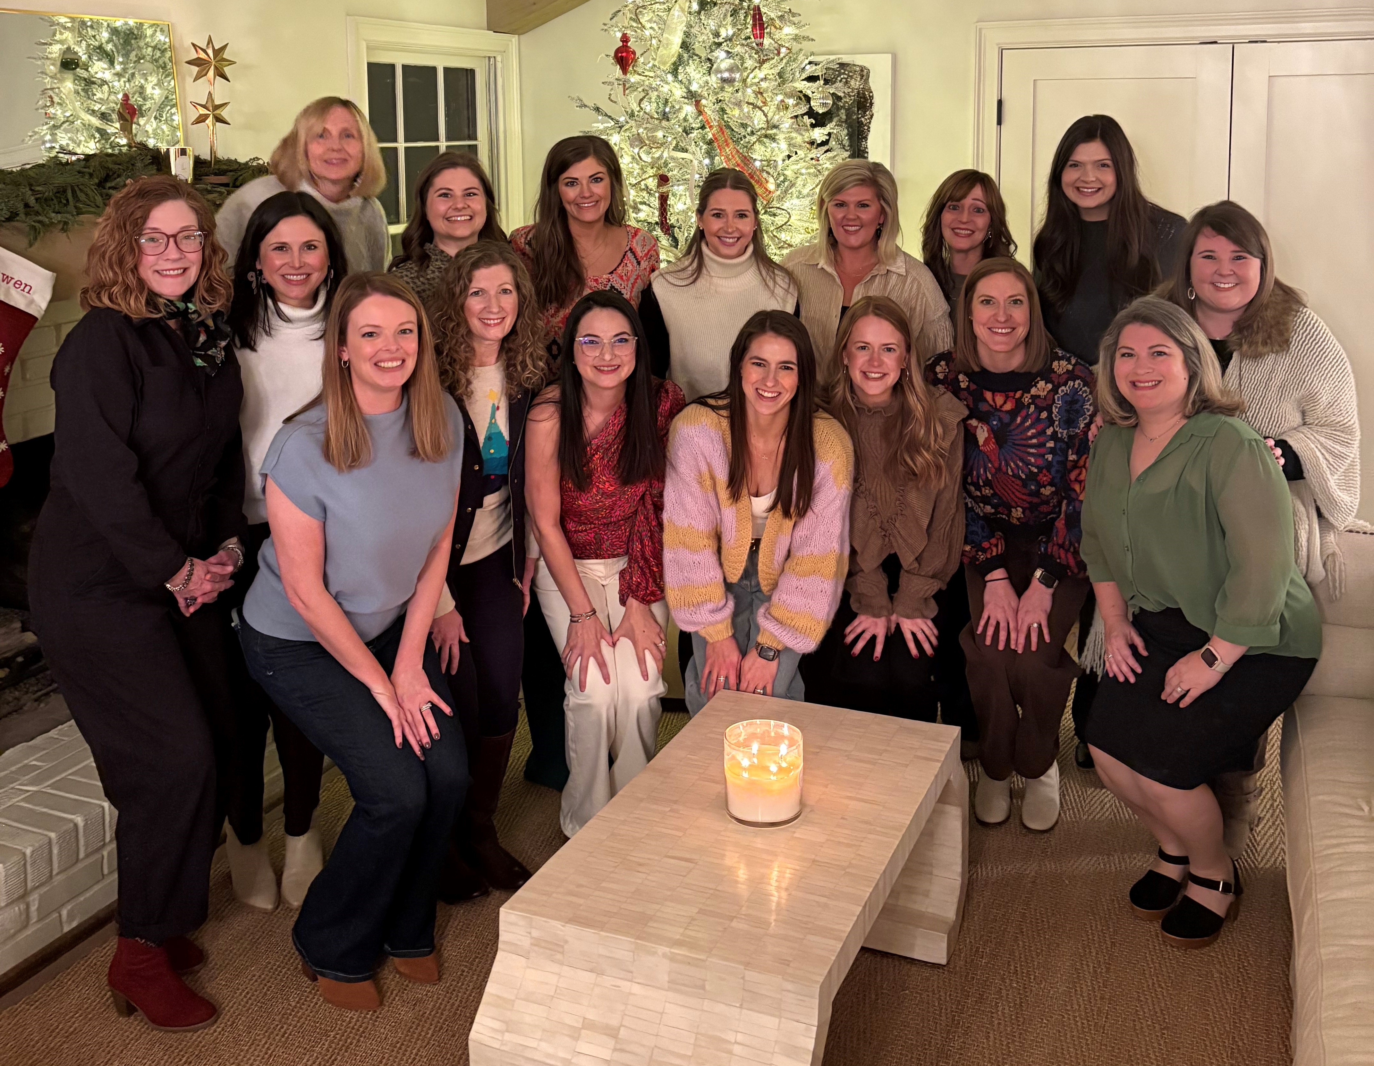
Contact Us!
Epic Chat
Email: APASS@childrensal.org
Phone: 205-638-6235
Notes:
The best way to contact us is through Epic chat, APASS email, or phone.

Slide 4
DHR Custody Policy
Parents/legal guardian of children in the temporary custody of DHR placed in out-of-home care must give informed consent for all surgical procedures and other procedures requiring anesthesia. If the parents/legal guardian are not available, DHR must seek a court order for any elective surgical procedure.
DHR may consent for basic medical care and hospitalization on children in the temporary custody of DHR.
Clinic staff ordering/scheduling procedure: It shall be the responsibility of clinic staff ordering and scheduling a procedure to determine DHR involvement or whether a complicated family dynamic exists that may impact procuring informed consent to the procedure and anesthesia. If either is identified, clinic staff shall involve Children's of Alabama Social Services and/or Risk Management prior to the day of surgery to help resolve the issue or to procure an appropriate court order. For assistance identifying complicated family dynamics or DHR involvement, please refer to the flowcharts referenced as exhibits A and B to this policy.
Notes:
We screen patients for DHR / potentially custody issues to help avoid any delays on the day of surgery. We rely heavily of information we receive from surgeon’s offices. This custody flow sheet can be found in Lucidoc and is helpful in determining who we should be getting consent from for elective OR cases.
DHR deems surgery and anesthesia to be “extraordinary medical care” which is why the standard for who provides anesthesia consent is higher. Most of the paperwork foster families bring to clinic allowing permission to “seek medical care” is not sufficient for surgery or anesthesia.

Slide 5
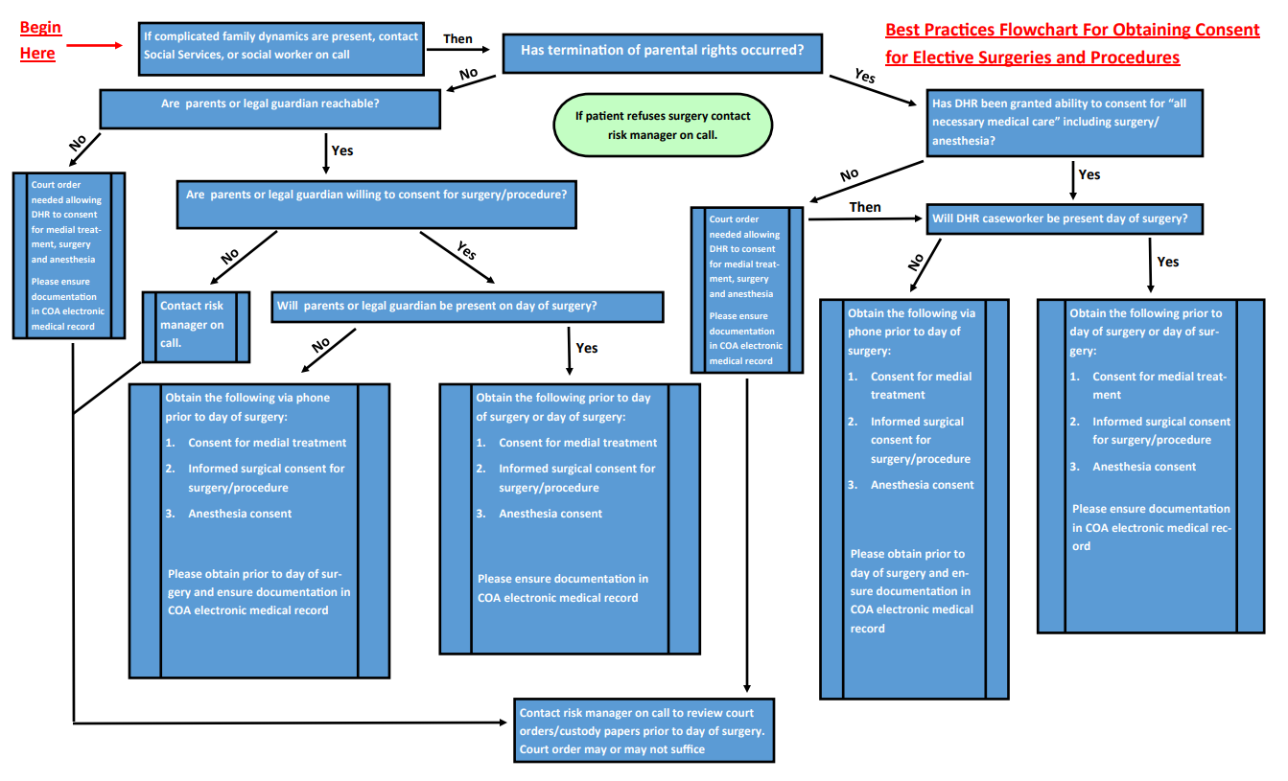
Custody Issues

Slide 6
Key Points
Assess who the legal guardian is when you see patients in clinic
If DHR is involved, use DHR Planning Form
Have parental rights been terminated?
Provide contact information for biological parents, foster parents, and DHR caseworker
If biological parents are unavailable, obtain court order from DHR
Reach out to social services, social worker on call, or risk management on call for any issues or further guidance.

Slide 7
Labs in the OR
Only applies to BR and Lowder facilities (excludes IR, imaging, and South
Ordering office must obtain clearance from the surgeon/proceduralist office FIRST.
Lab collection must be added to the OR schedule case and appear on the surgery schedule.
Requires 3 business days notice
Lab collection in the OR will require a medical necessity form from ordering\requesting physician\office
Requires approval from administration if labs are not on pre-approved list
Notes:
We recognized there is a need for certain patient populations to have lab work unrelated to their OR case while under general anesthesia. Surgical Services and the lab have been working on a policy to handle these situations with minimal disruptions on the day of surgery. The fully policy is not completed and approved yet, but please be on the look out.
In the meantime, our current policy is that labs unrelated to the surgical procedure are not collected in the OR under general anesthesia.

Slide 8
Questions?
Email: APASS@childrensal.org
Phone: 205-638-6235

